Slide 1

Swede Midge and
Canola Flower Midge Research Update
Rebecca H. Hallett
Angela Gradish, Graham Ansell

Slide 2
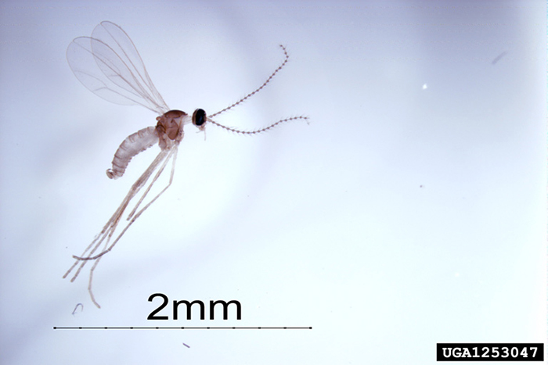
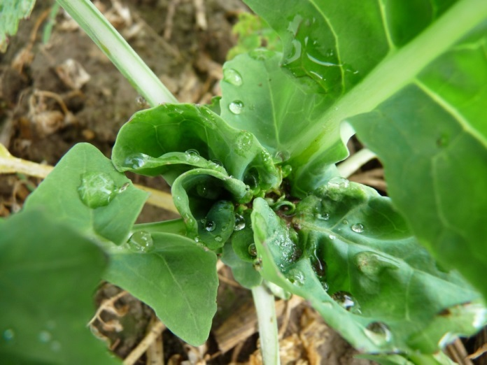
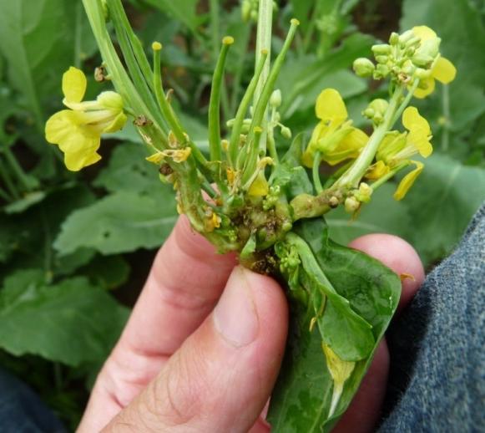
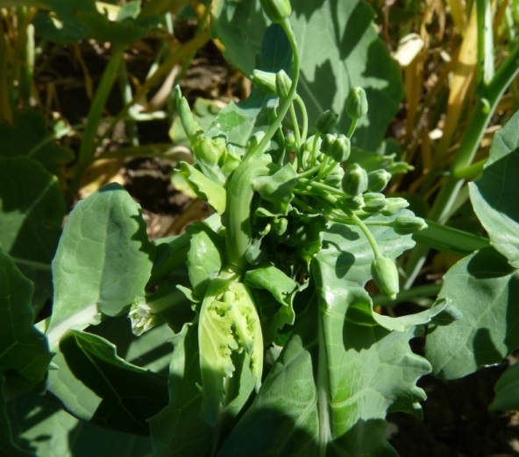
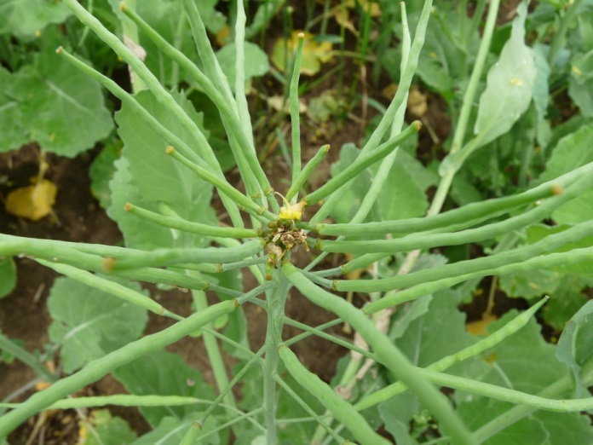
Swede Midge
Contarinia nasturtii (Cecidomyiidae)
First identified in Ontario in 2001, alien
Widespread in eastern North America
Damage to all stages of canola
Photo: Susan Ellis, USDA APHIS PPQ, Bugwood.org
Notes:
This is really a story about two cecidomyiid midges – the swede midge and the canola flower midge.
The SM is an alien species from Eurasia that was first identified in Canada in 2001. SM and has become widespread throughout eastern North America, where it infests any and all brassicaceous crops. In canola it causes damage to all stages from the vegetative rosette stage through to bud formation and branching

Slide 3
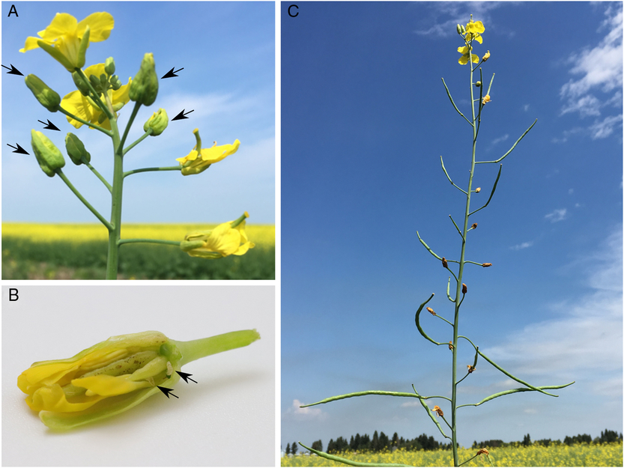
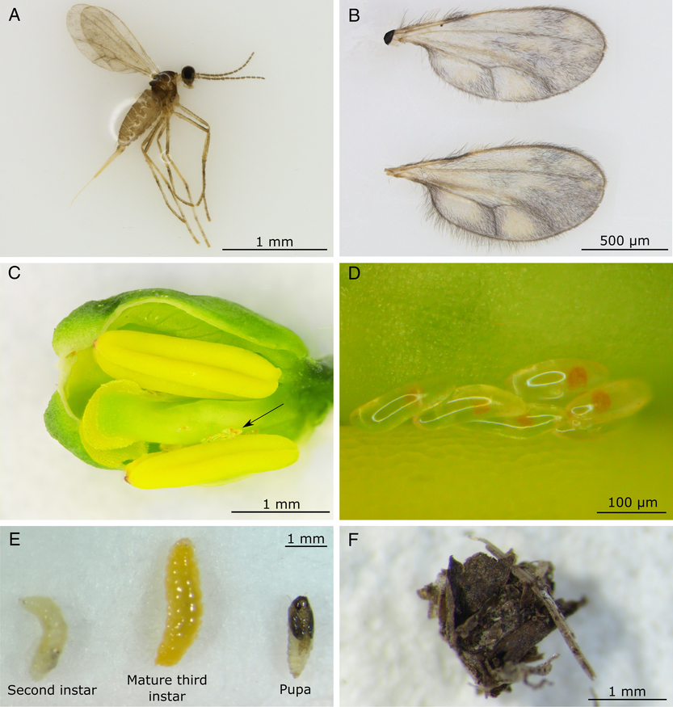
Canola Flower Midge
Contarinia brassicola
Damage symptoms first seen in western Canada in 2012
Species first identified in 2016
Source: Mori et al. (2019)
Notes:
Its congener, the canola flower midge is prevalent in western Canada. Damage symptoms are confined to the flowers. Damage symptoms of CFM were first seen in western Canada in 2012 – initially mistaken as SM-damage. Boyd and various collaborators subsequently identified it as a distinct species. And in collaboration with Boyd we were able to first detect it in ON in 2021

Slide 4

Differentiation from Swede Midge
CFM
SM
Source: Mori et al. (2019)
Photo: Susan Ellis, USDA APHIS PPQ, Bugwood.org
Mori, B. et al. (2019). A new species of Contarinia Rondani (Diptera: Cecidomyiidae) that induces flower galls on canola (Brassicaceae) in the Canadian prairies. The Canadian Entomologist 151(2):131-148.
Notes:
Diagnosis:
Mottled wings in female.
Antennal differences in females and males
Differences in shape of male genitalia and teeth on larval spatula

Slide 5
Damage symptoms in Western Canada
A - flower galls (arrows)
B - black, necrotic lesions on style (arrows indicate larvae)
C - dried, older flower galls
Galled flowers are the only observed damage symptom from CFM infestation of canola
Source: Mori et al. (2019)
Notes:
flower bud remains closed and becomes swollen, forming a gall
Larvae feed gregariously (1 to > 20), and black, necrotic damage (feeding scar) is often apparent on the style when later instars are present
Galled flowers produce no seed and are conspicuous from other normally developing buds and flowers
especially after they dry, later in the season
Occasionally, the style will continue to elongate and protrude from flowers closed around the base although other organisms can also cause this (e.g., aster yellows).
C – dried, older flower galls located at various places along the elongating raceme, no longer containing larvae.

Slide 6
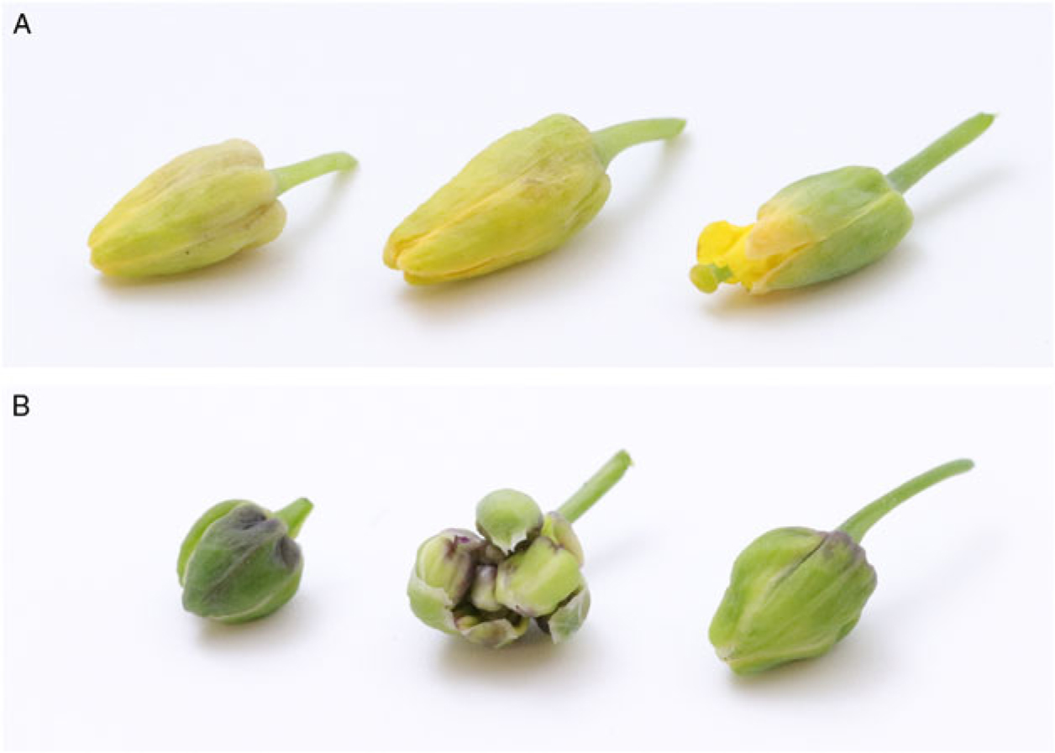
Flower galls
Swede Midge
‘Caper’ galls
Canola Flower Midge
‘Bottle’ galls
Source: Mori et al. (2019)
Notes:
A – CFM larval feeding within developing canola flower buds, results in a distinct bottle-shaped flower gall
B - The middle plant part in B is a C. nasturtii infested bud cluster; this type of damage has not been observed with C. brassicola.

Slide 7
CFM Damage
Affected buds fail to flower or produce seed.
Estimate that the infestation of one flower on a raceme by CFM causes a loss of ~9% of the potential yield from that raceme
Therefore, CFM has the potential to cause significant damage to canola
Vankosky, M.A. et al. 2022. Distribution and life history of Contarinia brassicola (Diptera: Cecidomyiidae) in canola (Brassica napus) grown on the Canadian Prairies. Agricultural and Forest Entomology. DOI: 10.1111/afe.12509
Source: Mori et al. (2019)

Slide 8

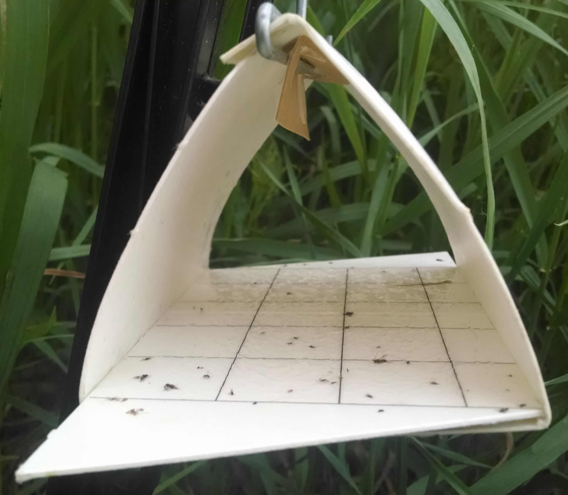

Detection in Ontario
Surveys in Ontario for the CFM bottle galls since 2016
  None seen
CFM sex pheromone became available experimentally in 2021
  Trapping at spring canola sites since 2021
Notes:
BOLD records: The one from Arkell was collected on June 26, 2015 and the Peterborough one was collected June 25, 2015. Both appear to have been collected in traps at edges of crop fields. Boith were in BOLD as unidentified sequences – species name put to them through Boyd and Bradley Sinclair’s work

Slide 9
Research objectives
The co-occurrence of these two species in Ontario and their ecological interactions have implications for pest management.
Our objectives are
Determine the distribution of CFM in Ontario,
Determine the phenology and abundance of CFM in Ontario canola in comparison to SM,
Determine the relative abundance and location of SM and CFM larvae on canola plants.

Slide 10
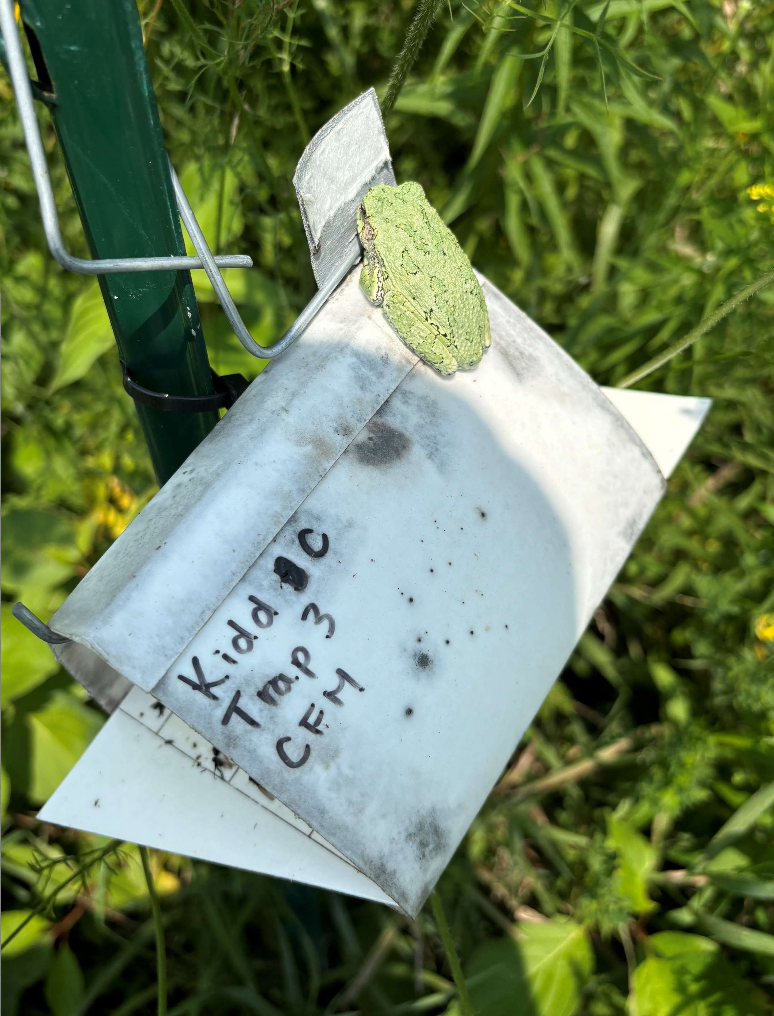
1. Distribution in Ontario
CFM and SM synthetic sex pheromone-baited traps
  Unique for each species
Spring canola fields – 2021 to 2025
  Dufferin, Wellington, and Bruce counties, Kawartha Lakes
  region, Timiskaming and Nipissing districts
Non-canola sites – 2023 to 2025
  2023 – 1 site, U of G Arboretum, Wellington county, naturalized area
  2024 – 1 site, Simcoe county, edge of potato field, near military base
  2025 – 2 sites, Norfolk county, naturalized area
Notes:
No Brassica crops near non-canola sites

Slide 11
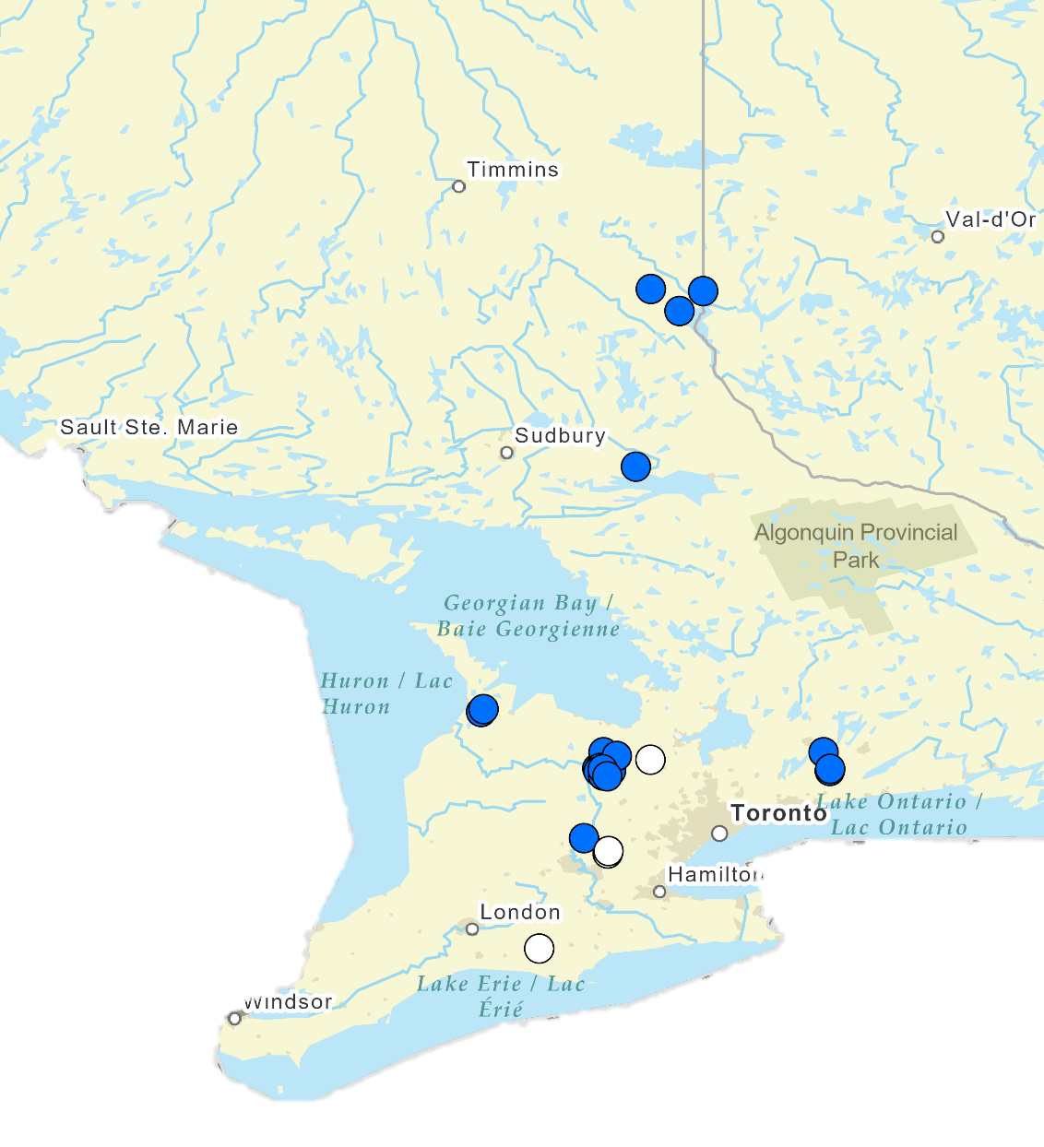
CFM Distribution:
2021 to 2025
CFM found in all sites where pheromone traps were set up
Both species are widely distributed in Ontario
canola
no canola

Slide 12
Distribution in Ontario
Both species are widely distributed in Ontario
  Presence also confirmed in QC
CFM has been found in all trapping locations
Both species have been trapped in the same canola fields
Males from both SM and CFM pheromone traps have been sequenced and species IDs have been confirmed

Slide 13
2. Phenology and abundance in Ontario
SM and CFM pheromone traps (2 - 4 pheromone traps/species/field)
Counted weekly
Canola fields: Dufferin county
  2 fields in 2022
  3 fields in 2023 to 2025

Slide 14
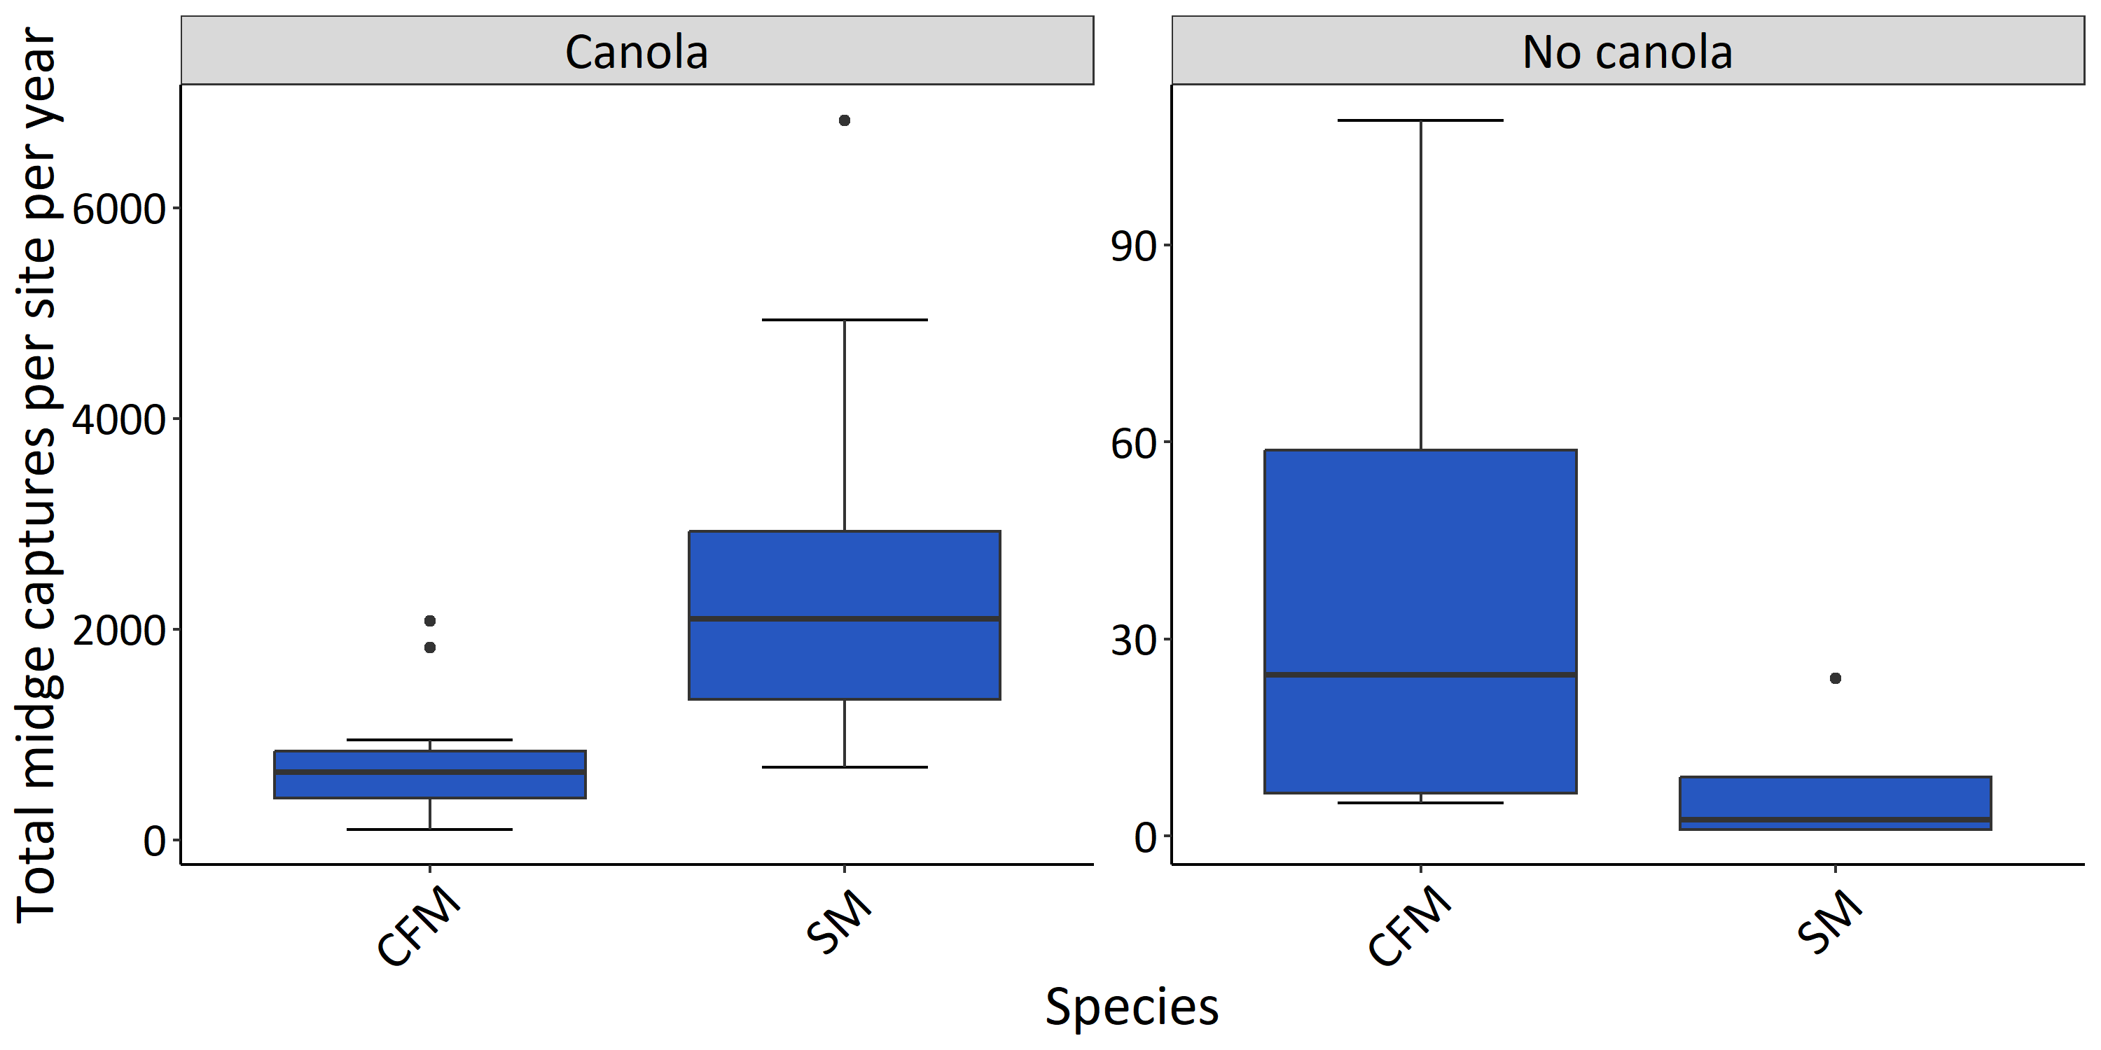
Canola Sites
Non-Canola Sites
Notes:
Males of both species trapped at all sites
Both more abundant at canola sites
More SM than CFM at canola sites
More CFM than SM at non-canola sites

Slide 15
Canola Sites
Non-Canola Sites
Notes:
Males of both species trapped at all sites
Both more abundant at canola sites
More SM than CFM at canola sites
More CFM than SM at non-canola sites

Slide 16
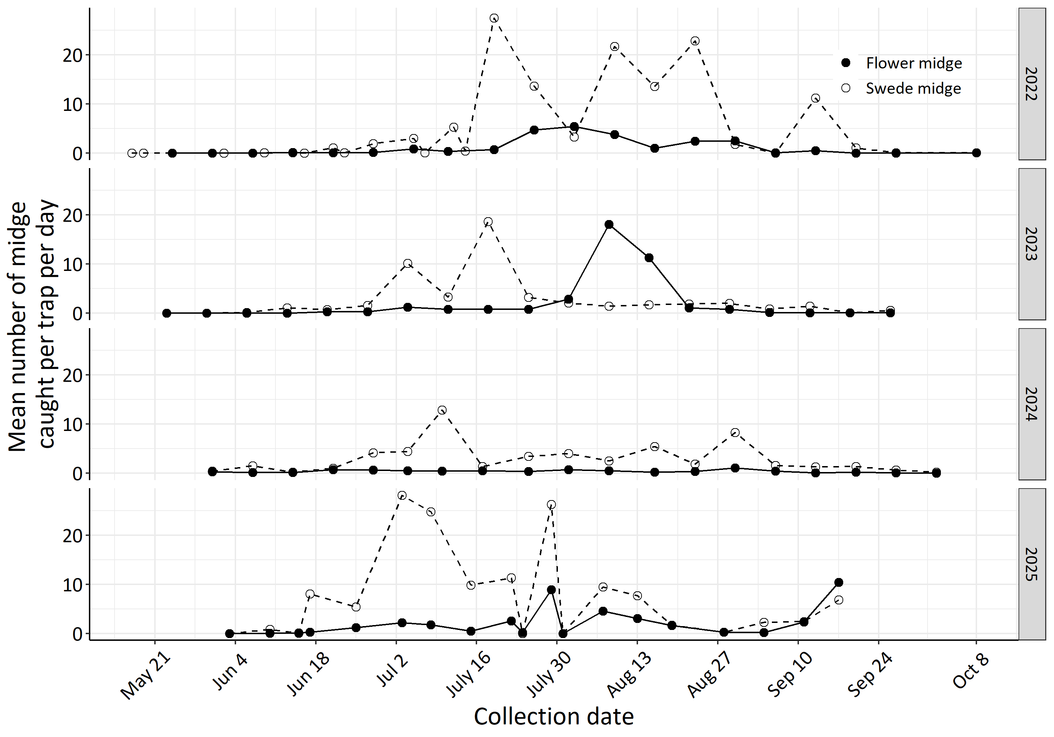
Pheromone trap captures: 2022-2025
--○-- SM
─●─ CFM
Mean no. males/trap/day
Notes:
Throughout the season, CFM is generally less abundant than SM ; daily captures of males on pheromone traps are rarely above 5 males/trap per day. Compared to SM, where captures of 10-20 males per trap per day are much more common.
Too early to say much about the phenology of CFM, but both midge species occur at the same times during the season.
In terms of phenology, as reported in previous studies for SM, multiple peaks of adult captures were observed from mid-June to September. Reflecting the occurrence of at least 2 emergence phenotypes and at least 2 generations per year.
For CFM, first emergence seems to be a little later than for SM, and it appears to be present for less of the growing season. But it’s too early to say much about phenology and voltinism due to limited data and a fair amount of variability among years.
[First (early- to mid-June) and peak (late-July to mid-August) adult captures of CFM occurred later than for SM. ]
Sampling on canola should have covered period larvae present; by Aug 7 canola is fully podded and beginning to dry up, not really suitable for larval development

Slide 17
Seasonal abundance in Ontario
CFM generally less abundant than SM.
Temporal overlap in species presence.

Slide 18
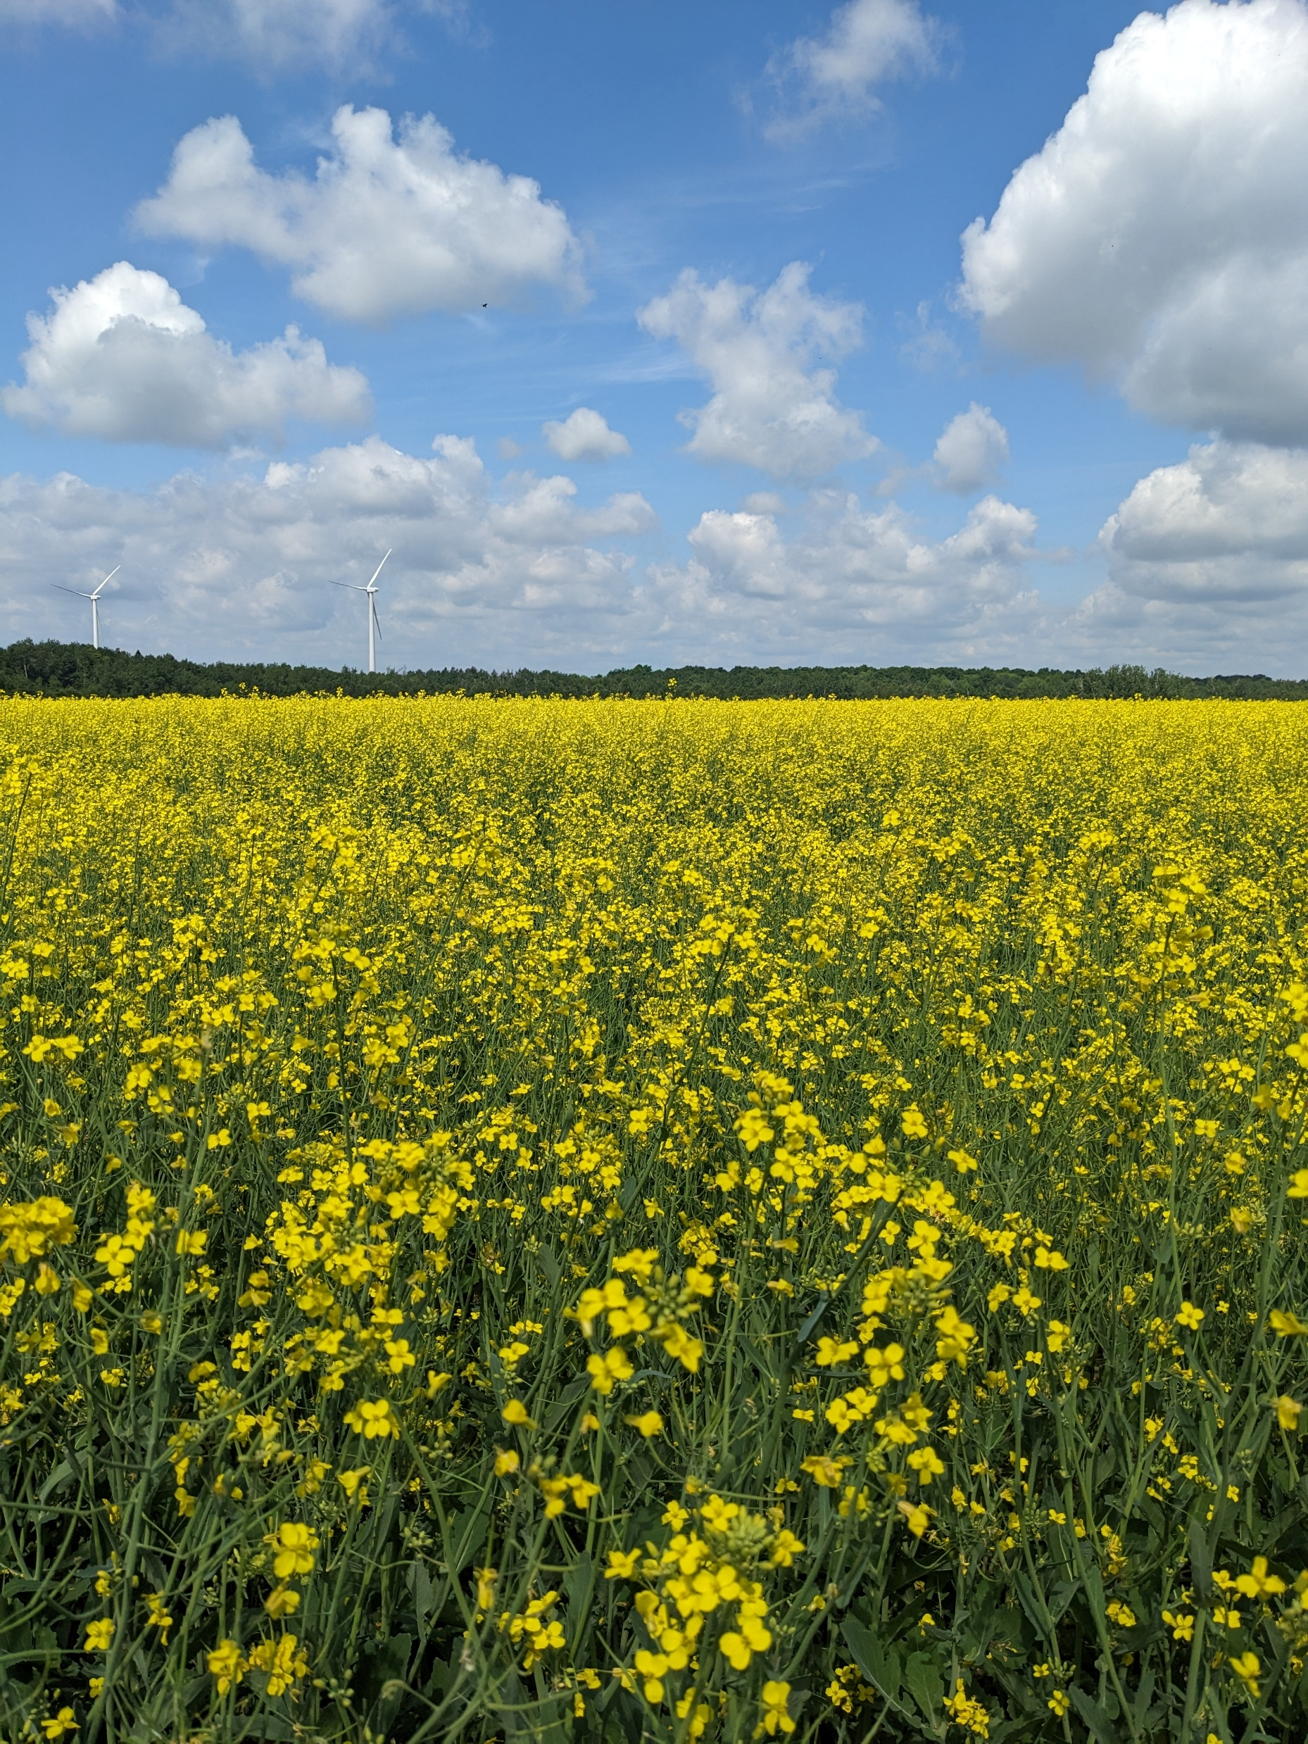
3. Presence on canola tissues
Determining which species is feeding where is important for assessing economic impact and planning management interventions
Weekly plant collections
21 June to 9 August 2022
Notes:
Plant collections 21 June to 9 August 2022,
30 plants/field, 2 fields, Dufferin county
Containers were held in controlled environment chambers (25˚C, 16:8 L:D, 30-50% RH) and emerged adults were removed 3 times/week. All emerged adults were stored in ethanol and later identified based on morphological characters.
Reproductive (growth point with visible bud or reproductive tissue) or vegetative (growth point without visible reproductive tissue).

Slide 19
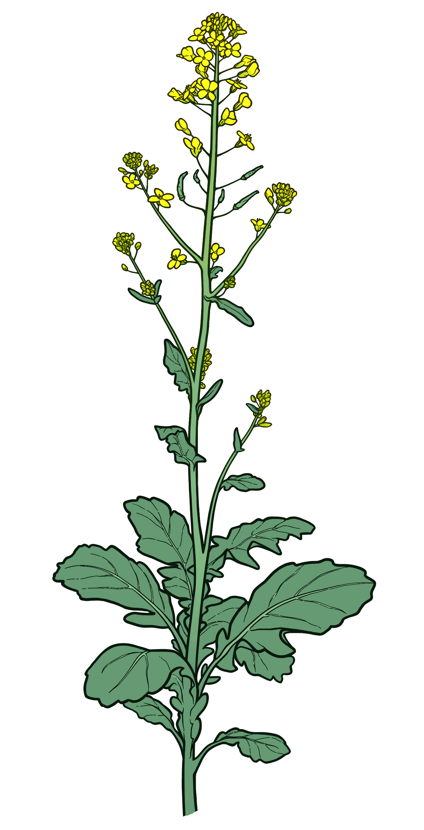


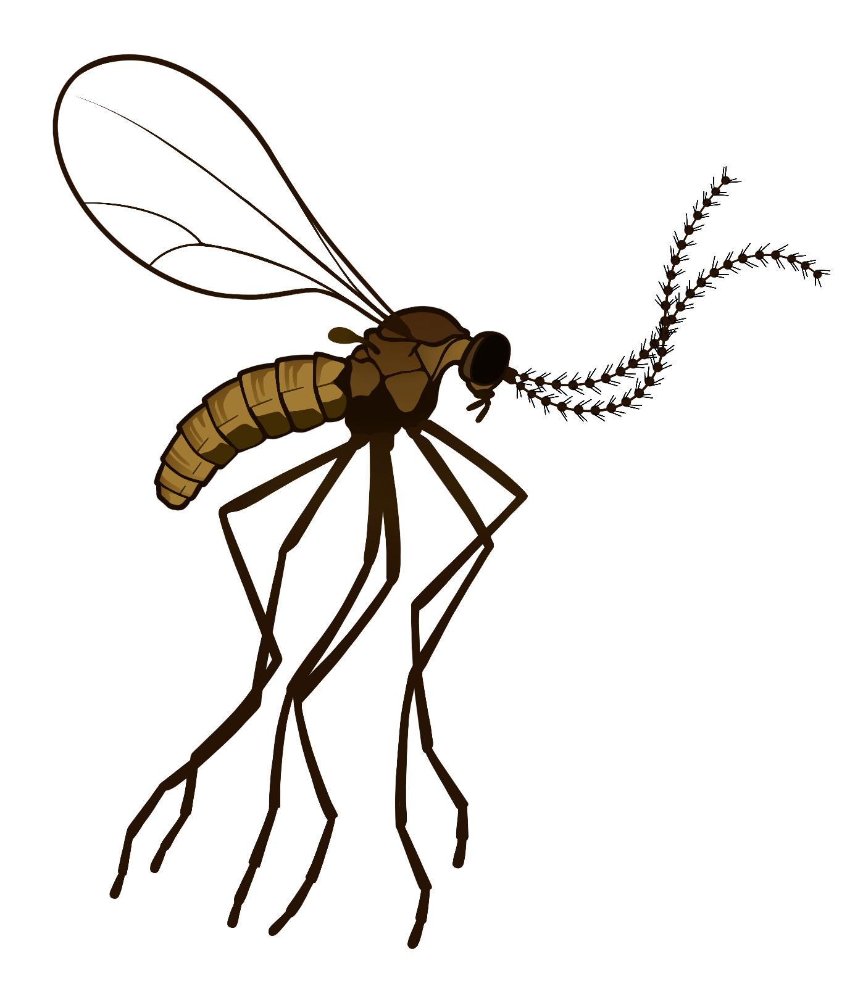
Morphological ID
Notes:
Morphological ID = Antennal characters

Slide 20
Presence based on Morphological IDs
5,790 adult midges emerged and were identified
692 were initially identified as CFM using morphology (12%)

Slide 21

Presence based on Morphological IDs
5,790 adult midges emerged and were identified
692 were initially identified as CFM using morphology (12%)
Barcoded a subset of these CFM-identified adults
All were found to be SM
Presence based on Molecular IDs

Slide 22
Presence on canola tissues [2022]
No CFM adults were found among midges that emerged from canola plants
Molecular identifications of individual larvae needed to determine whether CFM is developing on canola and on what tissues
Notes:
Almost all misidentified CFM were males

Slide 23
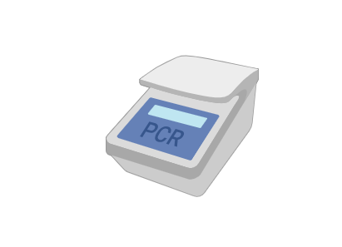
Molecular ID Assay
Amplify DNA from individual larvae with CFM-specific primers
ID based on presence/absence of band on agarose gel

Slide 24
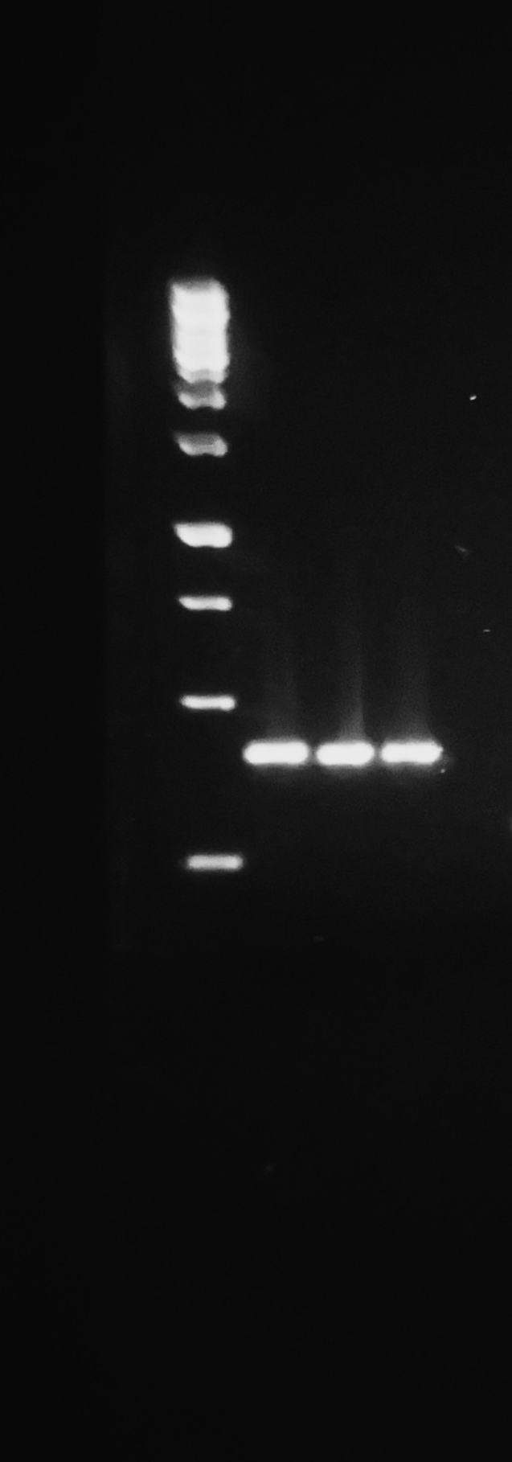
Primer Design
Designed species-specific primers for CFM and SM
FM_F/Lep_R
  In the presence of CFM DNA produces a 450 bp amplicon
100% efficacy and specificity for both primer pairs
CFM
Notes:
Using adult males collected on pheromone traps, we designed species-specific primers for both species. We focused on the barcoding region of COI because we had some barcode sequences available for both species and knew which barcoding primers worked well for that (LepF/LepR). We first sequenced some adults collected on pheromone traps to generate a library for primer design; however, there was only one site on that region of COI that was polymorphic enough for species-specific primer binding, so we couldn’t design a forward and reverse primer for either species. Instead, we used the polymorphic site to create a forward primer for CFM – FM_F - that when paired with Lep_R produces a ~450 bp amplicon and a reverse primer for SM – SM_R – that when paired with Lep_F produces a ~300 bp amplicon.
After optimizing our PCR conditions with each primer pair, we performed efficacy and specificity testing using SM and CFM adults, and both primer pairs were 100% effective and 100% specific (they always amplified the target species and never amplified the non-target species).
First 3 bands = the amplification of the DNA from 3 CFM adults using the primers FM_F/Lep_R (ca. 450 bp amplicon) and the last 2 bands = the amplification of the DNA from 2 SM adults using the primers Lep_F/SM_R (ca. 300 bp amplicon). In between = a skipped lane/nothing.
And the last lane was a negative control – I labelled it on the photo so you can see, but I don’t think you need to include that.
Note in case someone asks: Yes, in this reaction, I amplified 3 CFM and 2 SM – there WAS NOT a SM that failed. If they ask why, I can’t help you – I don’t remember why I did that 😅. I feel like I ran out of extraction for one SM but didn’t notice until I had already made everything up for this reaction.

Slide 25
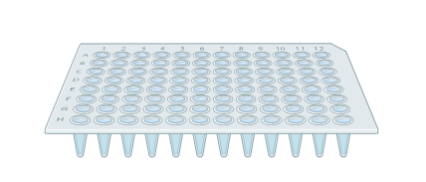
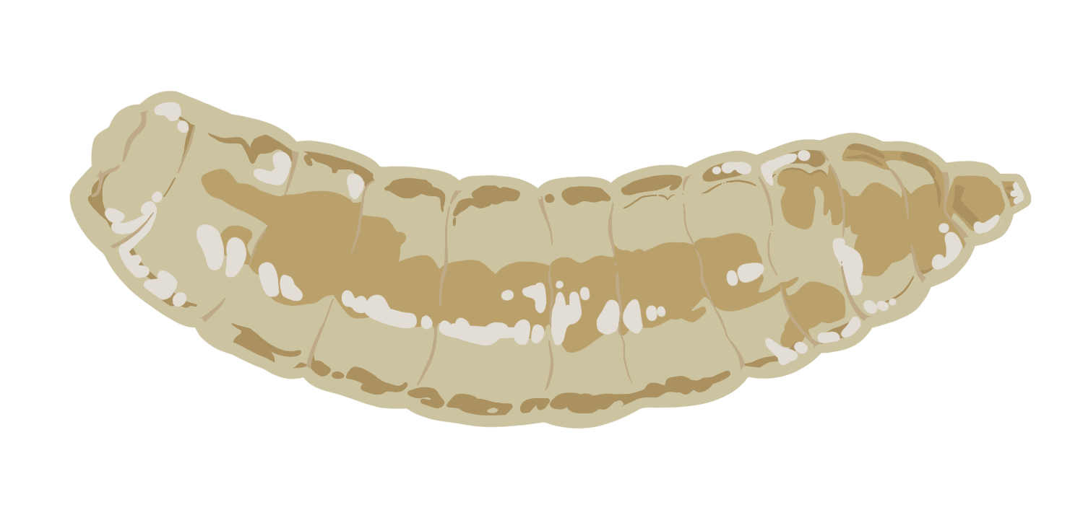

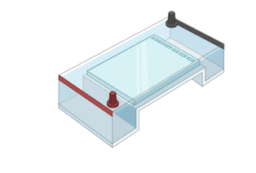
Larval Identification
FM_F
Lep_R
+
450 bp band = CFM
No band = SM

Slide 26
2024 Larval identification
Collected approx. 17,355 larvae from
  130 infested canola plants
  4 infested brassicaceous plants
Extracted and amplified DNA from 8,489 larvae
  58 canola plants
  6-18 plants per week from 27 Jun to 7 August
plus 20 larvae from other brassicaceous plants
Notes:
In 2024 and 2025, we collected canola plants weekly between June and August (growth stages 3.1 – 4.3) from the same fields we monitored for CFM and SM with traps near Shelburne. Each week, we collected ca. 20 plants with visible SM-like injury from the edges of each field (5 plants/edge). We also periodically searched for brassicaceous weeds at the edges of each field and collected any with visible evidence of gall midge infestation.
20 midge larvae collected from 3 yellow rocket plants and one unidentified brassicaceous weed
We then dissected each plant in the lab and collected all midge larvae. We divided up each plant into different tissue types (growth points, bud clusters, buds, flowers, and pods), and we removed and placed the larvae from each piece of each tissue type together in a microcentrifuge tube with 95% ethanol (e.g., if a plant had 5 buds, all larvae from each bud were placed in a separate tube, for a total of 5 groups of larvae). We stored the tubes in a freezer at -20 C until DNA extraction.
We extracted the DNA from individual larvae using an alkaline lysis protocol, and we amplified each extraction with the FM_F/Lep_R primer pair. We then ran the resulting PCR products out on a 1.5% agarose gel, and the presence of a ~450 bp band indicated the larva was a CFM, while the absence of a band indicated the larva was a SM.

Slide 27
2024 Larval identification
Presence of a band = CFM
No band = SM
pos controls
neg control
CFM positive controls
Notes:
This was a plate of larvae amplified with FM_F/Lep_R – all failed to amplify, hence no bands. The 2 visible bands are positive controls (DNA from 2 CFM adult males). The lane to the right of the last band = negative control lane (so there shouldn’t be anything there).

Slide 28
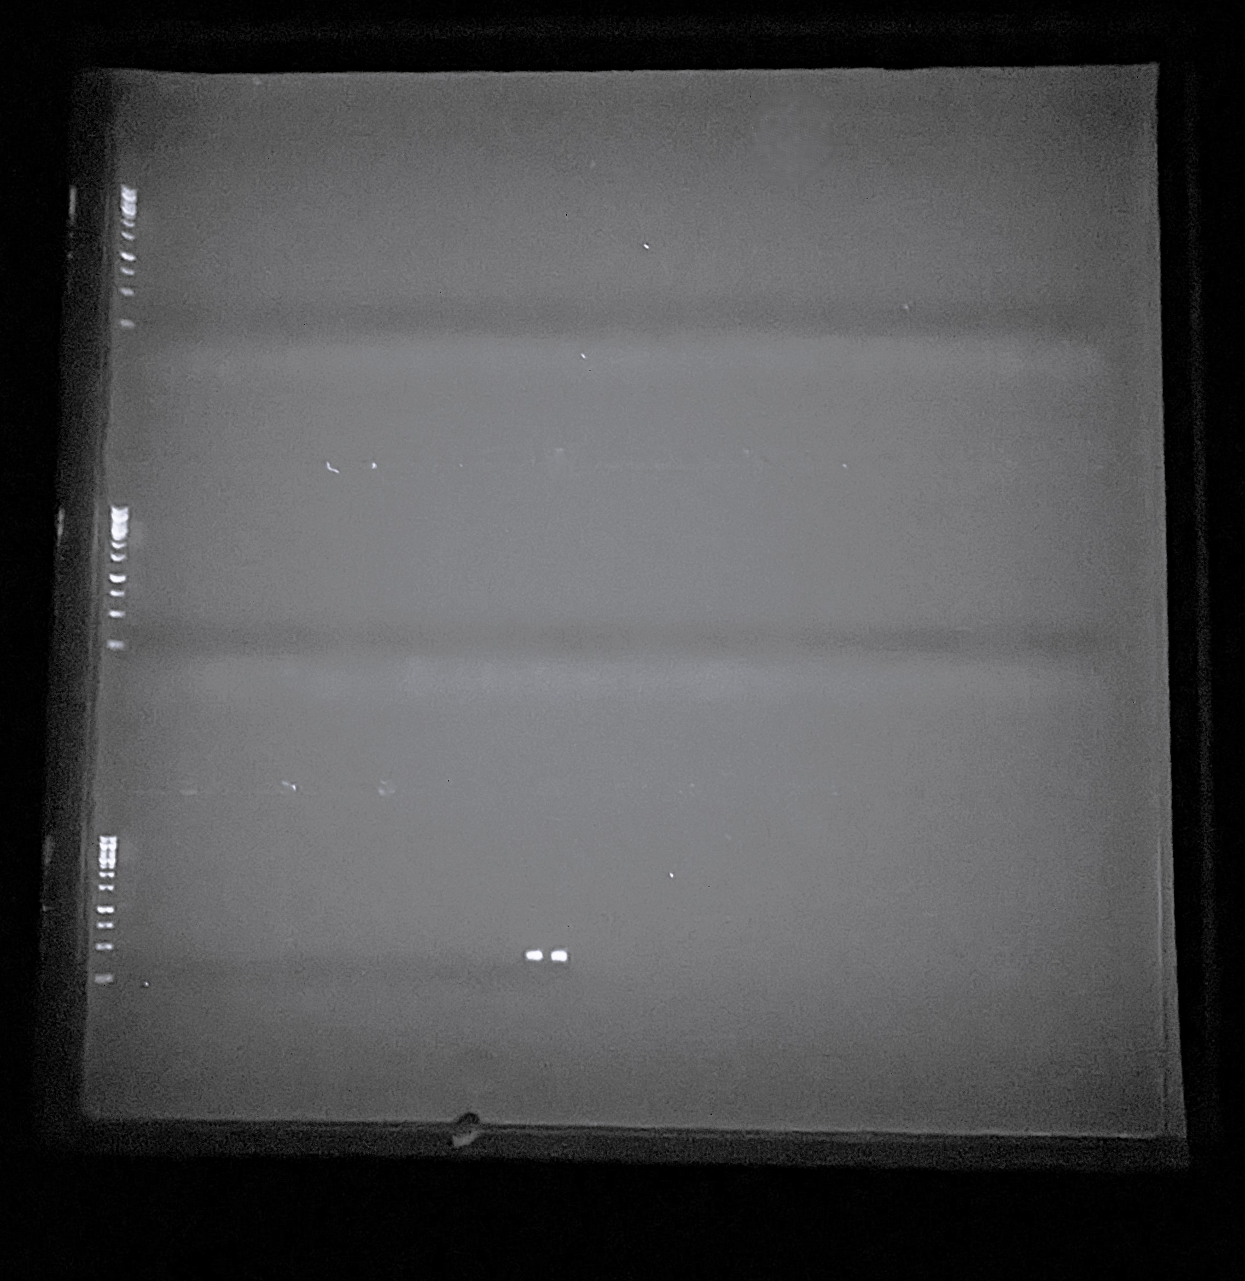
2024 Larval identification
Presence of a band = CFM
No band = SM
0 of 8,509 larvae were CFM
pos controls
neg control
CFM positive controls
Notes:
This was a plate of larvae amplified with FM_F/Lep_R – all failed to amplify, hence no bands. The 2 visible bands are positive controls (DNA from 2 CFM adult males). The lane to the right of the last band = negative control lane (so there shouldn’t be anything there).

Slide 29
2025 Larval identification
Collected approx. 28,510 larvae from
  241 infested canola plants
Extracted and amplified DNA from 5,873 larvae
  23 canola plants
    July 15, 22, 29
Notes:
In 2024 and 2025, we collected canola plants weekly between June and August (growth stages 3.1 – 4.3) from the same fields we monitored for CFM and SM with traps near Shelburne. Each week, we collected ca. 20 plants with visible SM-like injury from the edges of each field (5 plants/edge). We also periodically searched for brassicaceous weeds at the edges of each field and collected any with visible evidence of gall midge infestation.
20 midge larvae collected from 3 yellow rocket plants and one unidentified brassicaceous weed
In total, we sampled 241 plants (stages 4.1 – 4.3) from 3 canola fields, and from those we collected approximately 28,510 larvae. We did not collect any non-canola brassicaceous plants
We then dissected each plant in the lab and collected all midge larvae. We divided up each plant into different tissue types (growth points, bud clusters, buds, flowers, and pods), and we removed and placed the larvae from each piece of each tissue type together in a microcentrifuge tube with 95% ethanol (e.g., if a plant had 5 buds, all larvae from each bud were placed in a separate tube, for a total of 5 groups of larvae). We stored the tubes in a freezer at -20 C until DNA extraction.
We extracted the DNA from individual larvae using an alkaline lysis protocol, and we amplified each extraction with the FM_F/Lep_R primer pair. We then ran the resulting PCR products out on a 1.5% agarose gel, and the presence of a ~450 bp band indicated the larva was a CFM, while the absence of a band indicated the larva was a SM.

Slide 30
2025 Larval identification
Of 5,873 larvae…
  5,481 are SM
  Up to 32 could be CFM
    Bands are very pale
    Now testing DNA extracts of individual larvae to confirm identity
Notes:
One week ago I would have told you that all of these were SM
But one week ago today (27 January 2026), Angela let me know that … 5481 were definitely SM, but up to 32 MIGHT be CFM
2024+2025 Total of 14,382 larvae – DNA extracted and amplified so far
DO them in batches, so there are two wells that had bands, 16 larvae per well, no need to go back to individual larval extracts to determine identity.

Slide 31
Conclusions
  CFM is widespread in Ontario
    Relatively low population density
    Highest density in or near canola fields
  Is CFM using canola as a host plant in Ontario?
    Not on canola at all?
    Low population density, so not detecting it?
    What are its alternate hosts?
  More genetic analyses and life history studies needed

Slide 32
Acknowledgements
Funding sources:
Ontario Agri-Food Innovation Alliance (OMAFA-Univ of Guelph Partnership)
Ontario Canola Growers Association
Facilitators:
Meghan Moran and Abigail Wiesner, OMAFA
Dr. Boyd Mori, U of Alberta
Cooperating canola growers
Research assistants:
N. Byrne, C. El Hani, C. Grant, M. Pope, L. Rocha-Sersanti, N. Savoia, S. Schmidtke, D. Skelton, E. Stevens and H. Trainor
Illustrations:
S. Schmidtke

Slide 33
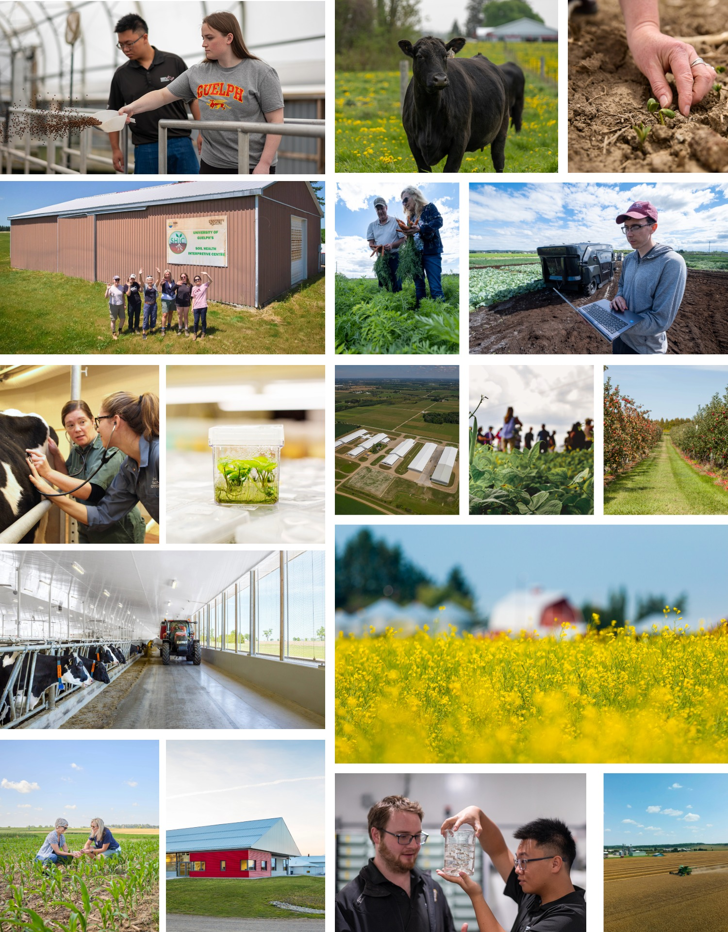

Strengthening Ontario’s Agri-Food Innovation Advantage
Ontario is facing increasing global pressures
Agri-food is a foundational economic sector in Ontario
The Ontario Agri-Food Innovation Alliance, a long-standing partnership between the Government of Ontario and the University of Guelph, delivers research, innovation, laboratory capacity, and highly qualified talent to support the province’s agri-food sector
  Delivers real, on-farm and value-chain impact
  Provides a 3X return on investment for producers, industry, and government
Sustained investment in the Alliance ensures Ontario producers remain competitive, profitable, and resilient in a volatile global market
Notes:
Ontario faces increasing global pressures
Trade uncertainty, supply-chain volatility, climate impacts, and food-system security risks require sustained innovation capacity.
Agri-food is a foundational economic sector in Ontario
~$51B in GDP contribution and a major driver of rural economies, exports, and domestic food supply stability.
The Ontario Agri-Food Innovation Alliance
A long-standing partnership between the Government of Ontario and the University of Guelph that delivers research, innovation, laboratory capacity, and highly qualified talent to support the province’s agri-food sector.
Alliance research delivers real, on-farm and value-chain impact
Crop resilience, pest and disease management, soil health, climate adaptation, productivity gains, and food safety innovations.
Proven return on investment for producers, industry, and government
The Alliance triples the investment by the Government
Attracts federal and private investment, accelerates commercialization, and helps reduce long-term system risks and costs.
Sustained investment in the Alliance ensures Ontario producers remain competitive, profitable, and resilient in a volatile global market
Strengthens sector competitiveness and food-system resilience and ensure preparedness for future challenges.

