Slide 1
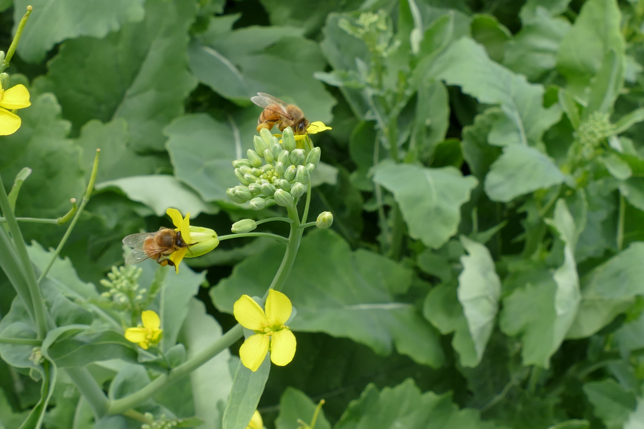
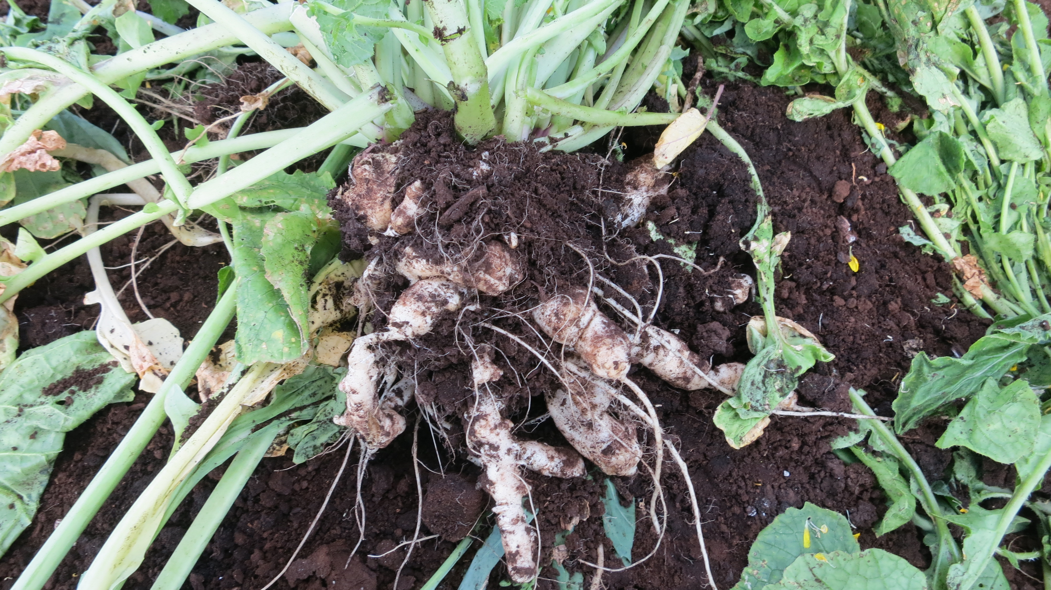
Clubroot research update
Mary Ruth Mcdonald, Kelly ruigrok, mckenna Campbell, Afsaneh sedaghatkish, Kirsten holy, bruce D. Gossen

Slide 2
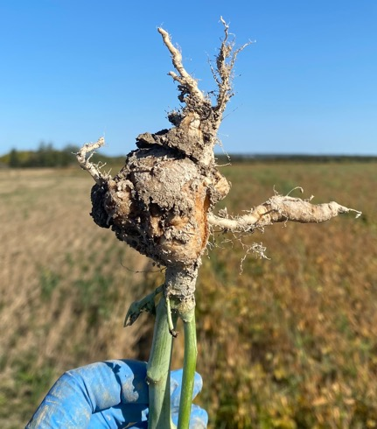
Identification and Management
  Detection
  Spread
  Pathotypes
  Resistance
  Crop rotation, cover crops
  Soil amendments-pH vs lime
Clubroot:
Plasmodiophora brassicae

Slide 3
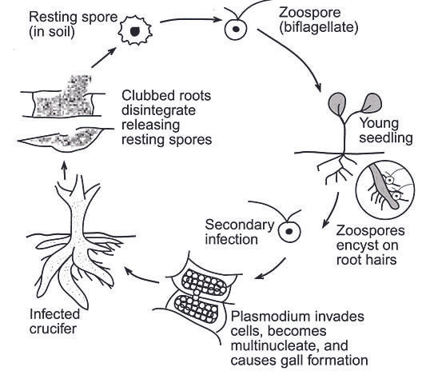
Life cycle of the clubroot organism Plasmodiophora brassicae
Obligate pathogen
LIFECYCLE
Notes:
Visible symptoms begin after the secondary infection phase (Ingram & Tommerup, 1972).
Cell hypertrophy & hyperplasia (rapid reproduction and increased cell size)
Club formation
Resistant brassica lines have been identified (Ayers, 1957) and focus on inhibition of the secondary infection phase (Deora et al., 2012). Genetic resistance is the method of choice for managing clubroot, but resistance is generally based on single pathotype- specific genes and, although highly effective, is not durable.
Some cultural controls focus on reducing resting spore populations in the soil for the forthcoming brassica crop

Slide 4
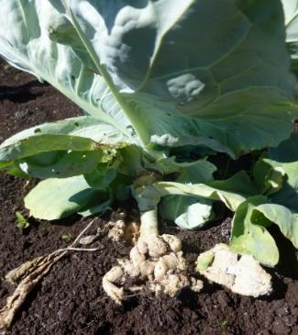
Where did clubroot come from?
From Europe in 1800’s, probably on turnips
Clubroot has been on vegetables in Ontario for at least a century
It spread throughout the Holland Marsh by flooding during Hurricane Hazel in 1954
Relatively new on canola in Western Canada Alberta (2003) and in Ontario (2016)
Clubroot spread rapidly in Alberta and is now in Saskatchewan and Manitoba;
New strains that can overcome resistance in canola

Slide 5
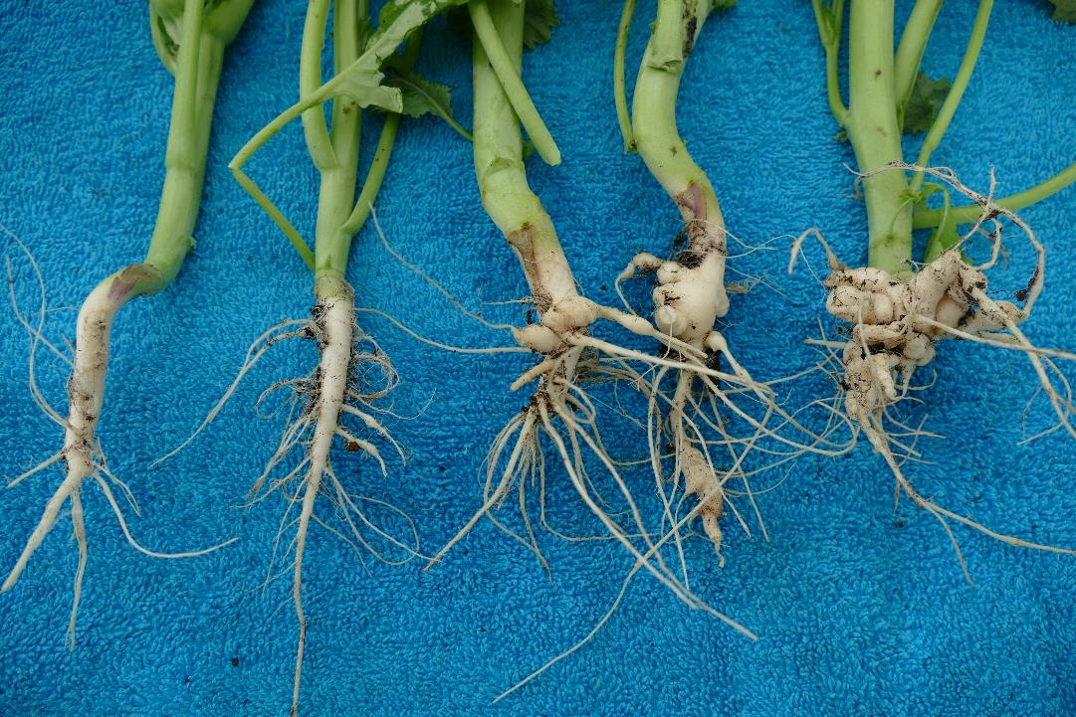
Resting spores: It‘s all about the numbers
Keep the numbers as low as possible!
< 1,000 1,000 10,000 100,000 1,000,000
Clubroot severity at different concentrations of resting spores
This will vary with soil conditions

Slide 6
Change in resting spore concentration over time – Saskatchewan
Fallow=
No crop
9 million
3 million
One million resting spores per gram can still cause 100% clubroot
Resting spores decline in the first two years after canola, then very little change

Slide 7
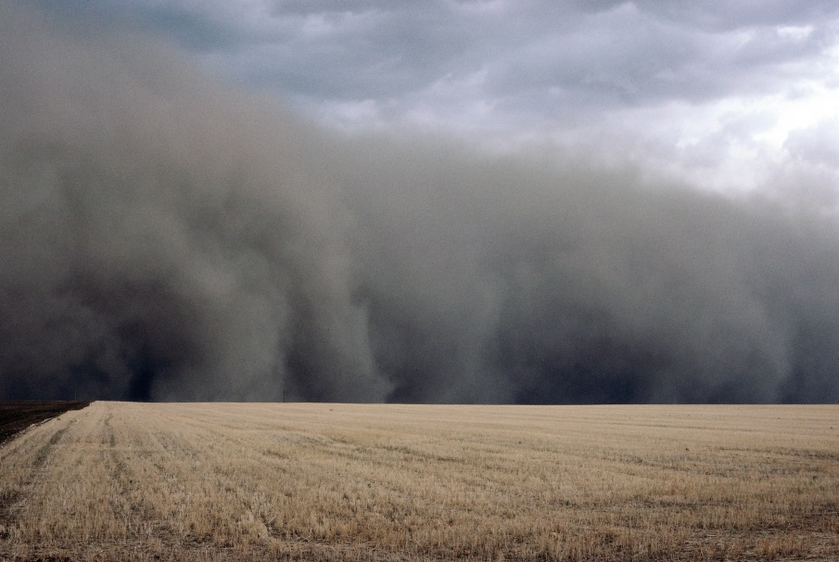
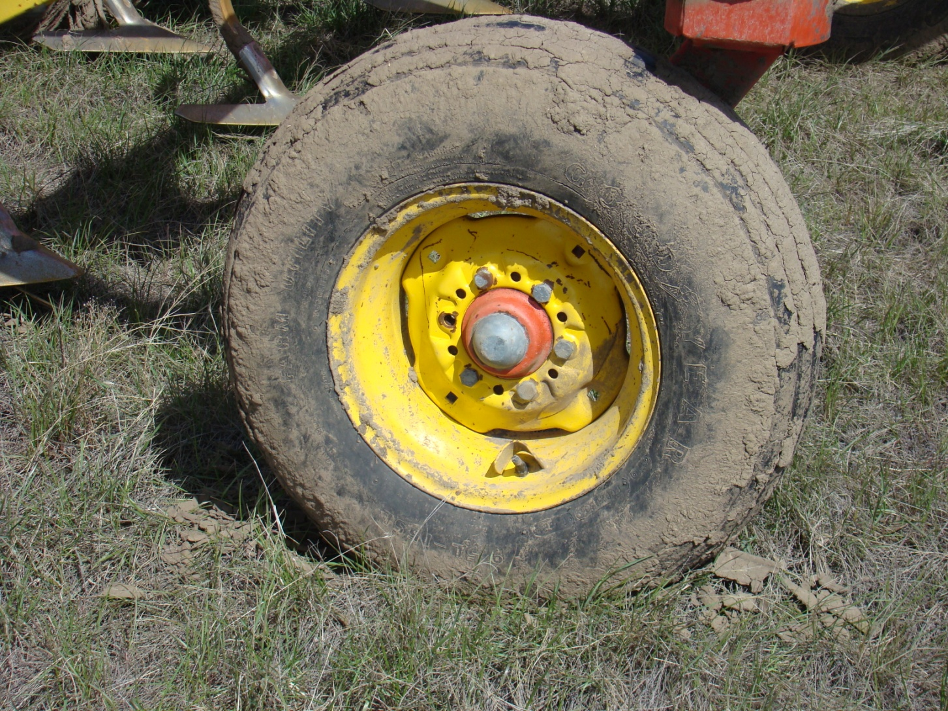
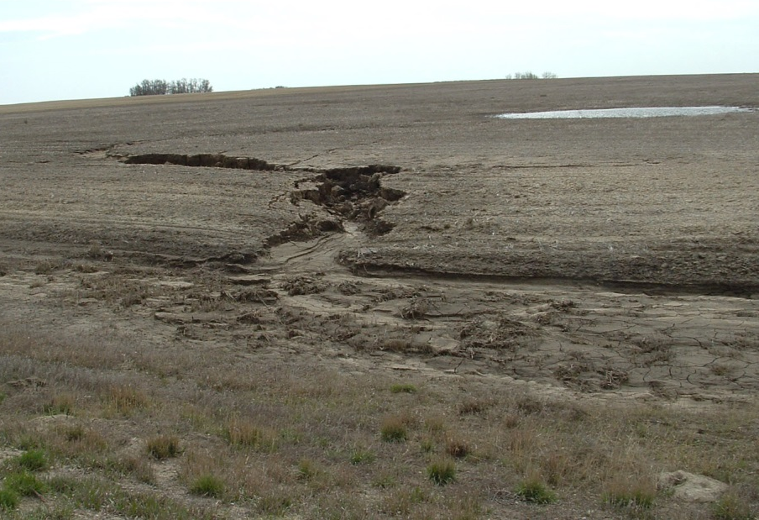
How does clubroot spread?
Anything that moves infested soil
Dust – not very important
Water erosion
Soil on equipment

Slide 8
P. brassicae resting spore survival in water
- Some drop over a month, then gradual decline
Freezer
90% viable to start
Freezing and thawing, still about 30% of spores are alive after 150 days

Slide 9
Clubroot spread in water
Resting spores can stay alive in water for a long time- at least 2 to 5 months
They survive longest when frozen
~ 50% at 75 days at room temp = 22 C
Water temperature doesn’t make much difference
This was in clean water- survival in rivers and ditches?

Slide 10
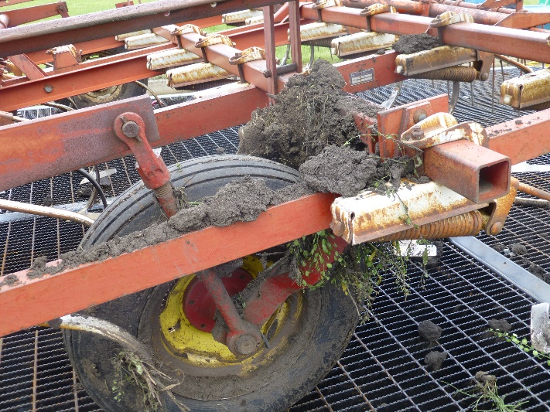
Recommendations for clubroot management
Prevent spread from field to field
This can be because of soil on equipment
  Cleaning and disinfecting is time consuming
  Removing the visible clumps can be 95% effective
  Not always possible to know which fields are infested
Alberta 2016

Slide 11
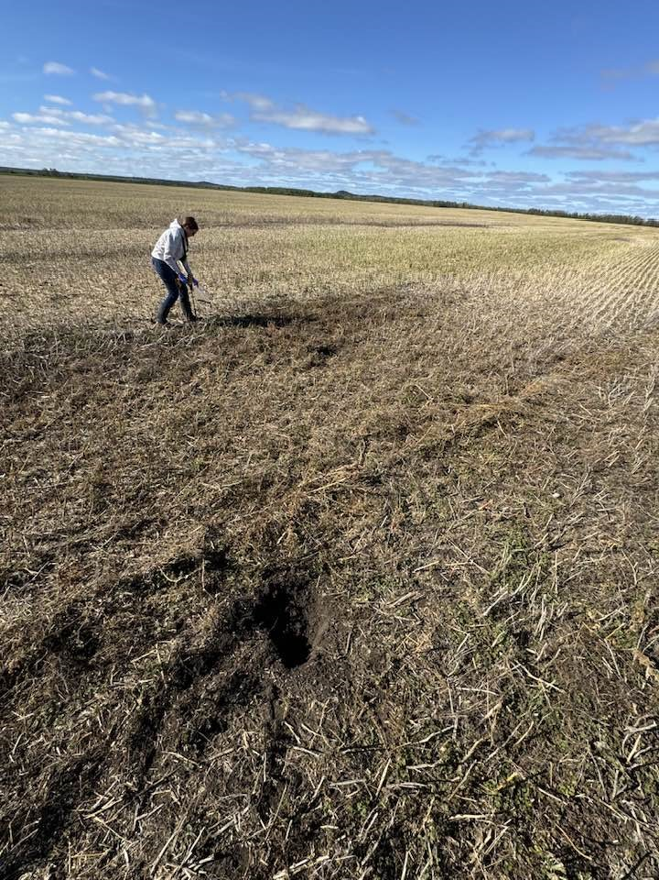
It is possible to test soil for the presence of the clubroot pathogen (AFL Labs in Guelph)
but even when the pathogen is found, there are still questions.
Finding the DNA doesn’t tell us how severe the disease will be
If no DNA is found, that is not a guarantee that there will be no clubroot

Slide 12
The concentration of resting spores is highly variable
Example Alberta research site
PCR results total resting spores
 | plot 1 | plot 2 | plot 3 | plot 4 | plot 5
Block 1 | 137,097 | 3,783,380 | 85,987 | 1,073,189 | 2,529
Block 2 | 3,290 | 698,927 | 1,463,110 | 123,188 | 56,916
Block 3 | 14,411 | 0 | 117,508 | 735,706 | 14,832
BUT it is difficult to get a representative soils sample.
A negative result is not a guarantee that there is no clubroot in the soil
Each square is 12 x 12 m. Five soil cores to 15 cm were sampled per plot and combined for assessment Assessed with molecular methods (qPCR).

Slide 13
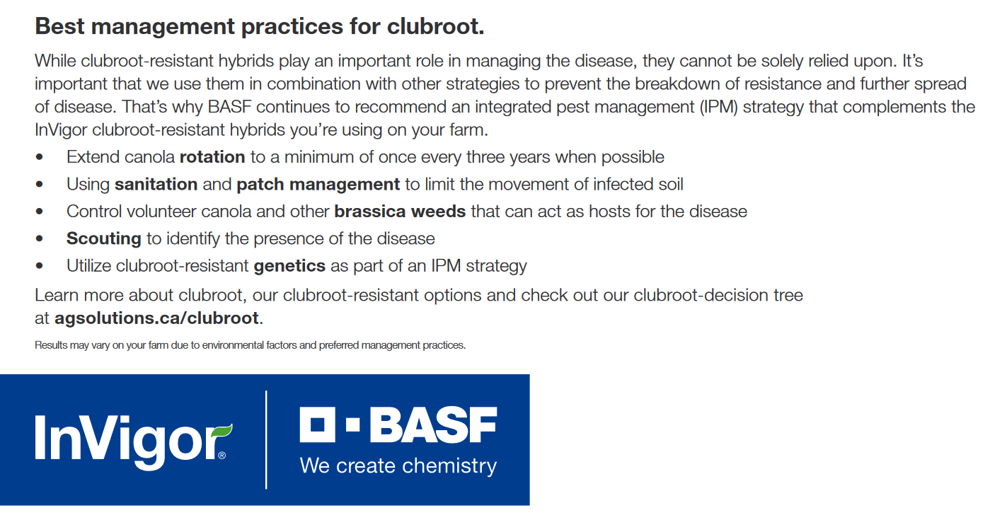

Slide 14
Clubroot resistance and pathotype of P. brassicae
A pathotype (strain) can cause disease on one crop or cultivar, but not another
The common pathotype on vegetables is 6
First pathotypes found on canola in Alberta were 5 and 3
The first clubroot resistant canola was introduced in 2009 = 45H29
This became known as ‘first generation resistance’
Clubroot that could over come this resistance was found by 2013. New canola with stacked genes are called ‘second generation resistance”
Winter canola Mercedes is very susceptible to clubroot

Slide 15
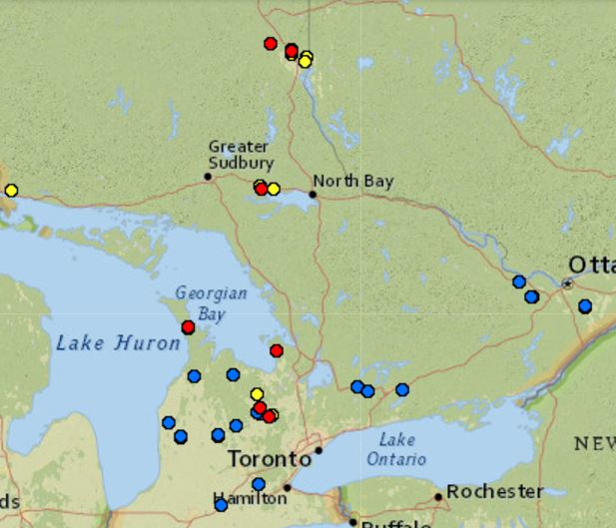
No P. brassicae DNA
P.
Clubroot symptoms on vegetables
P. brassicae DNA
P2
Clubroot symptoms on canola
First report of clubroot on canola in Ontario in 2016
The McDonald lab is still interested in receiving clubroot clubs
Send directly to me, or give to your crop consultant
P2
P6
P2
P5
P2
P6
P6
P6
2017- Pathotypes 2 and 5
Fig. 1. Map of canola and Brassica vegetable fields surveyed for clubroot in 2017. Fields where the pathotype (P) of P. brassicae was identified are indicated. The field where clubroot was first reported on canola in Ontario in 2016 is circled.

Slide 16
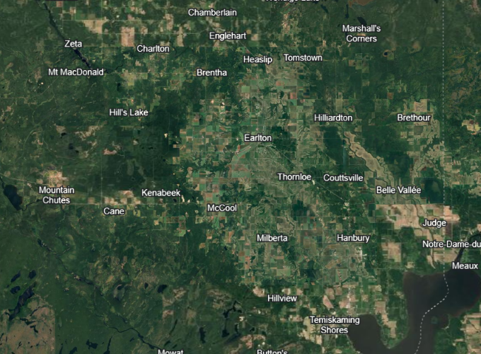
Continuing sample collection and pathotyping
2024
  10 Locations
2025
  5 Locations

Slide 17
Pathotypes in northern Ontario
In our assessments of clubs from 2020 – 2023, the pathogen could overcome first generation resistance
Pathotypes
2020: 8 fields plus one of volunteer canola
2023: 4 fields
2024: 10 fields
2025: 5 fields- pathotyping ongoing
2024: Pathotypes 2A, 2D and 3M
- based on Alberta CCD (Canadian Clubroot Differential set but some did not fit the CCD)
Eight could overcome first generation resistance, two (pathotype 2) did not
Work by Kirsten Holy, Komathy Prapagar, McKenna Campbell

Slide 18
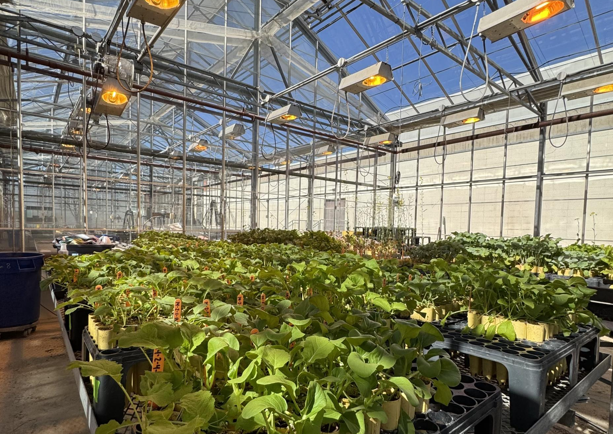
Pathotyping under way in the greenhouse.
It takes time and labour to determine a pathotype- minimum of 14 weeks

Slide 19
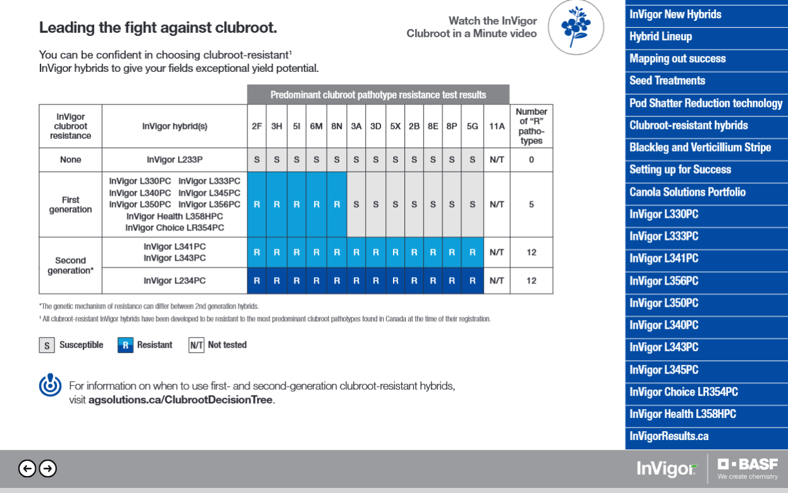
Pathotypes 2, 2D and 3M in northern Ontario

Slide 20
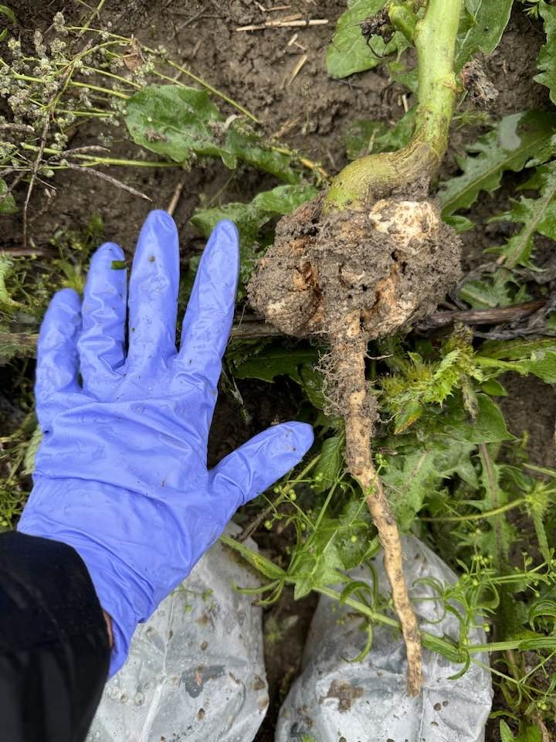
Why did the new pathotypes develop so quickly and what can be done to stop this rapid change?
There can be a billion resting spores in one club = lots more in a field.
There are different pathotypes in a club, certainly in a field
Growing a resistant variety is the best way to manage clubroot BUT this also selects for rare pathotypes that can overcome resistance
Essential to keep resting spore numbers low:
Alberta – Recommendation: Keep Clubroot Low and Local
More spores = more chance of resistance breaking down

Slide 21
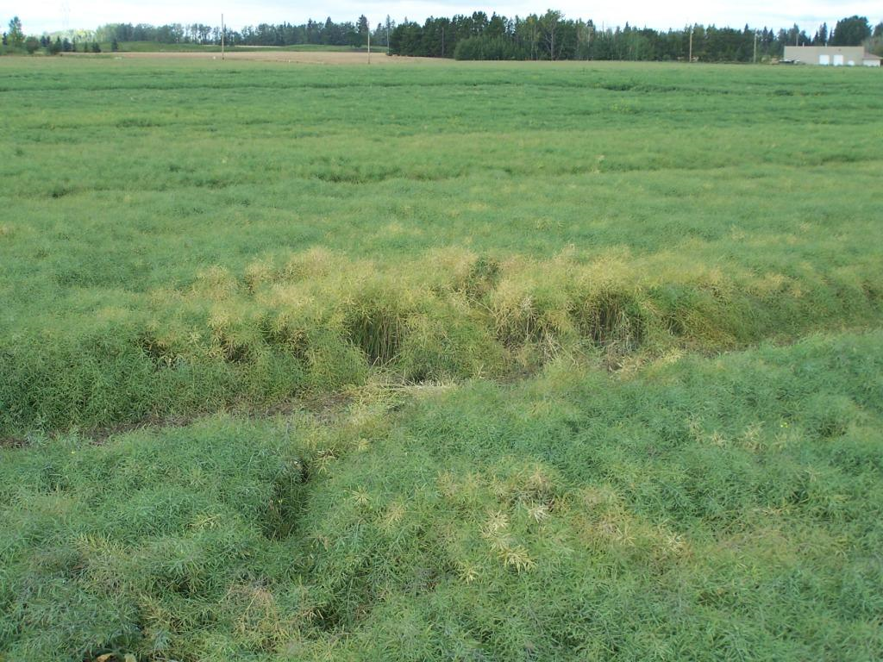
Scouting: It is usually difficult to detect soilborne diseases in the early stages
The first few diseased plants will be hard to see in a field
A patch may be attributed to other causes, such as a low spot
If something looks different, pull up plants and look at the roots
Patches of clubroot in Alberta canola

Slide 22
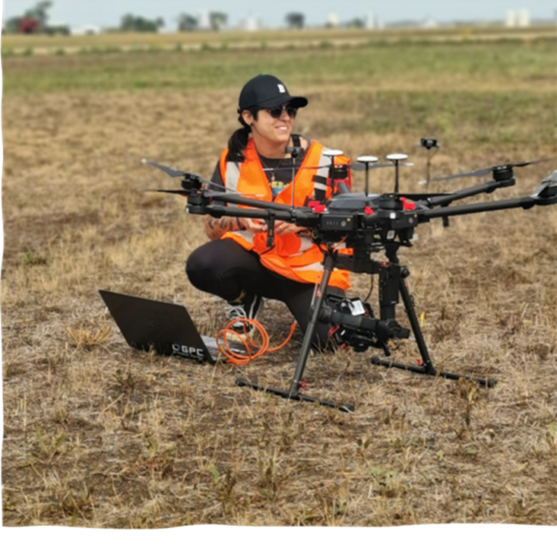
There may be hope for drone scouting
(collaborators David Halstead, Leila Benmerrouche, Bruce Gossen)

Slide 23

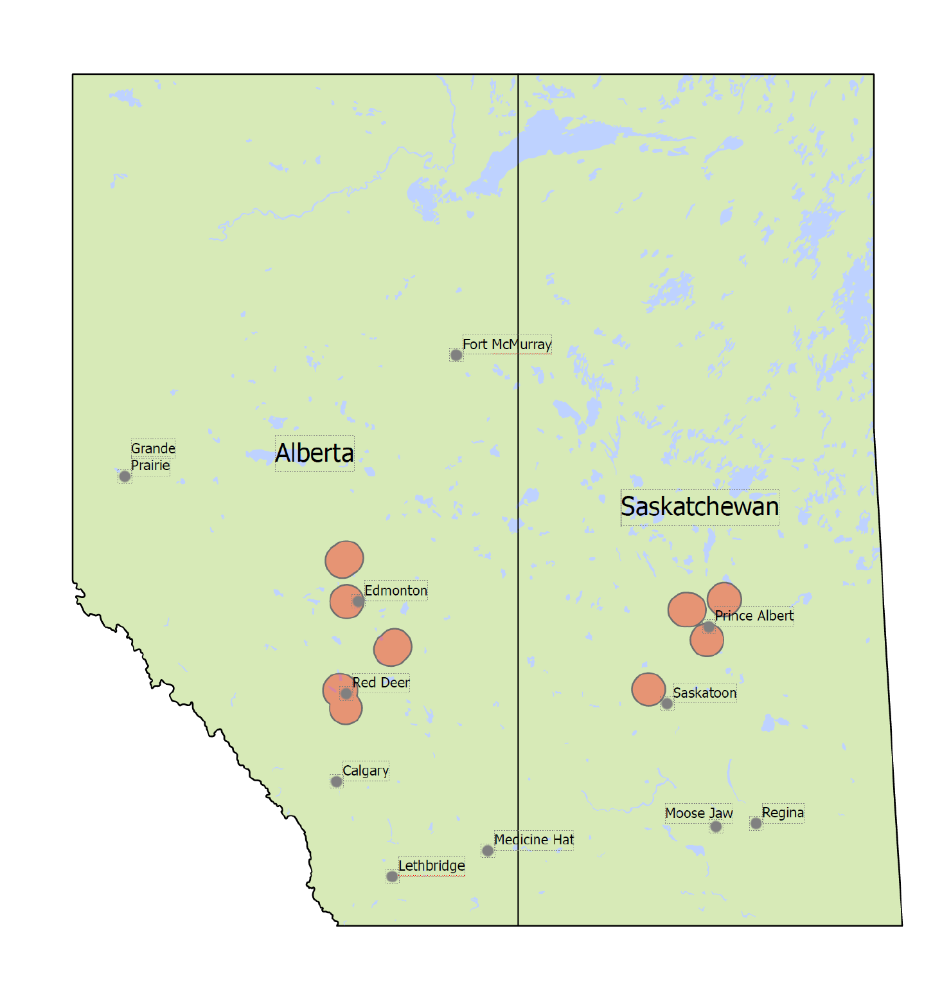
Methods
Hyperspectral data collected from 21 research and producer sites across AB and SK, 2021–2023.
Sampling focused on field entrances, where clubroot was most likely to occur.
Used a Headwall Photonics Nano-hyperspectral camera mounted on a DJI M600 Pro.
Each flight covered 0.5 to 4 ha.
Notes:
B1 Local Crop Specialists invaluable for identifying candidate sites, written permission from all producers/researchers
B2 Biosecurity measures were also implemented to ensure we were not aggravating the situation
B3 Nano hyperspec captures 273 bands of reflectance information in the 399 – 1001 nm range.
Discriminatory power
B4 For those concerned about incident light, radiance calibration was conducted in advance of every mission and a calibration tarp was included in each scene for accurate assignment of reflectance signatures
Photos

Slide 24
Results
Distinct difference in the spectral signature between healthy and clubroot infected canola.
Differentiating clubroot from non-clubroot plants involved the near infrared and red and green portions of the visible spectrum.
Notes:
Thanks DL Seeds

Slide 25

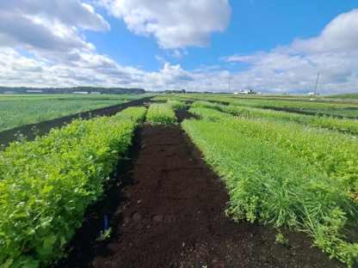


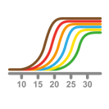
Management : Root Exudates & Spore Germination
A method to reduce resting spores in soil
Soil test in Spring pre-planting
Daikon and ryegrass cover crop
Burndown and plant canola
Fig 1. Daikon and ryegrass cover crop at Bradford Research Station.
RCBD, 8 blocks, plot size 1.5 m x 5 m
Soil test at harvest and qPCR
19
Notes:
Field trials at the Bradford Research Station with naturally infested soils (pH 6.3, organic matter 70%) , will be repeated in year 2
RCBD with six blocks, 1.5 m x 4 m plots
Cover crops grow for several weeks in Spring, burndown with herbicide, followed by L233P canola bioassay
Soil samples before and after trial for pH and inoculum concentration in the soil
qPCR for resting spore analysis
The quantity of P. brassicae DNA in soil will be determined using quanti-tative PCR. Preplant soil samples were taken from each replicate to quantify the initial concentration of spores and postplant sam-ples were taken from each pot to quantify the final concentration of spores.

Slide 26
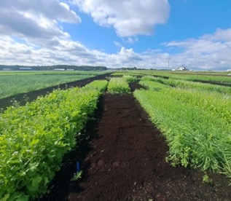
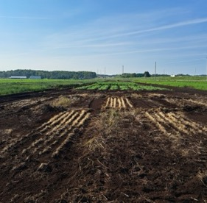
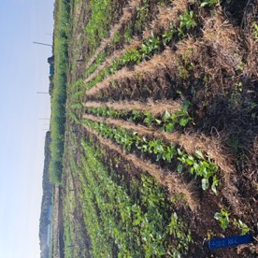
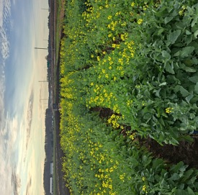
Bait Crops Trial - OCRS
Fig. 1 Daikon radish, bare soil, fall rye
Fig. 2 Post burndown and removal of residue – no till
Fig 3. Canola emergence one-week post-seeding
Fig 4. Canola severity assessment
Soil sampling: (A) Pre-bait crop, (B) Post-burndown, (C) Canola final assessment

Slide 27
Resting spores in soil 2024
Concentration x 1 million
No clubroot in this trial- Seeded in August in dry soil

Slide 28
Resting spores in soil 2025
Concentration x 1 million
Clubroot severity 45- 60%- no significant differences

Slide 29
Change in resting spore concentration over time – Saskatchewan
Fallow=
No crop
9 million
One million resting spores per gram can still cause 100% clubroot
3 million
Resting spores decline in the first two years after canola, then very little change

Slide 30
Are there rotation crops or cover crops that can help to reduce clubroot?
Spore numbers drop over time, especially during the first year, even with no crop
Oilseed radish and tillage/daikon – type radishes do not increase clubroot.
Some cover crops or rotation crops may produce a small drop – spring wheat, ryegrass

Slide 31
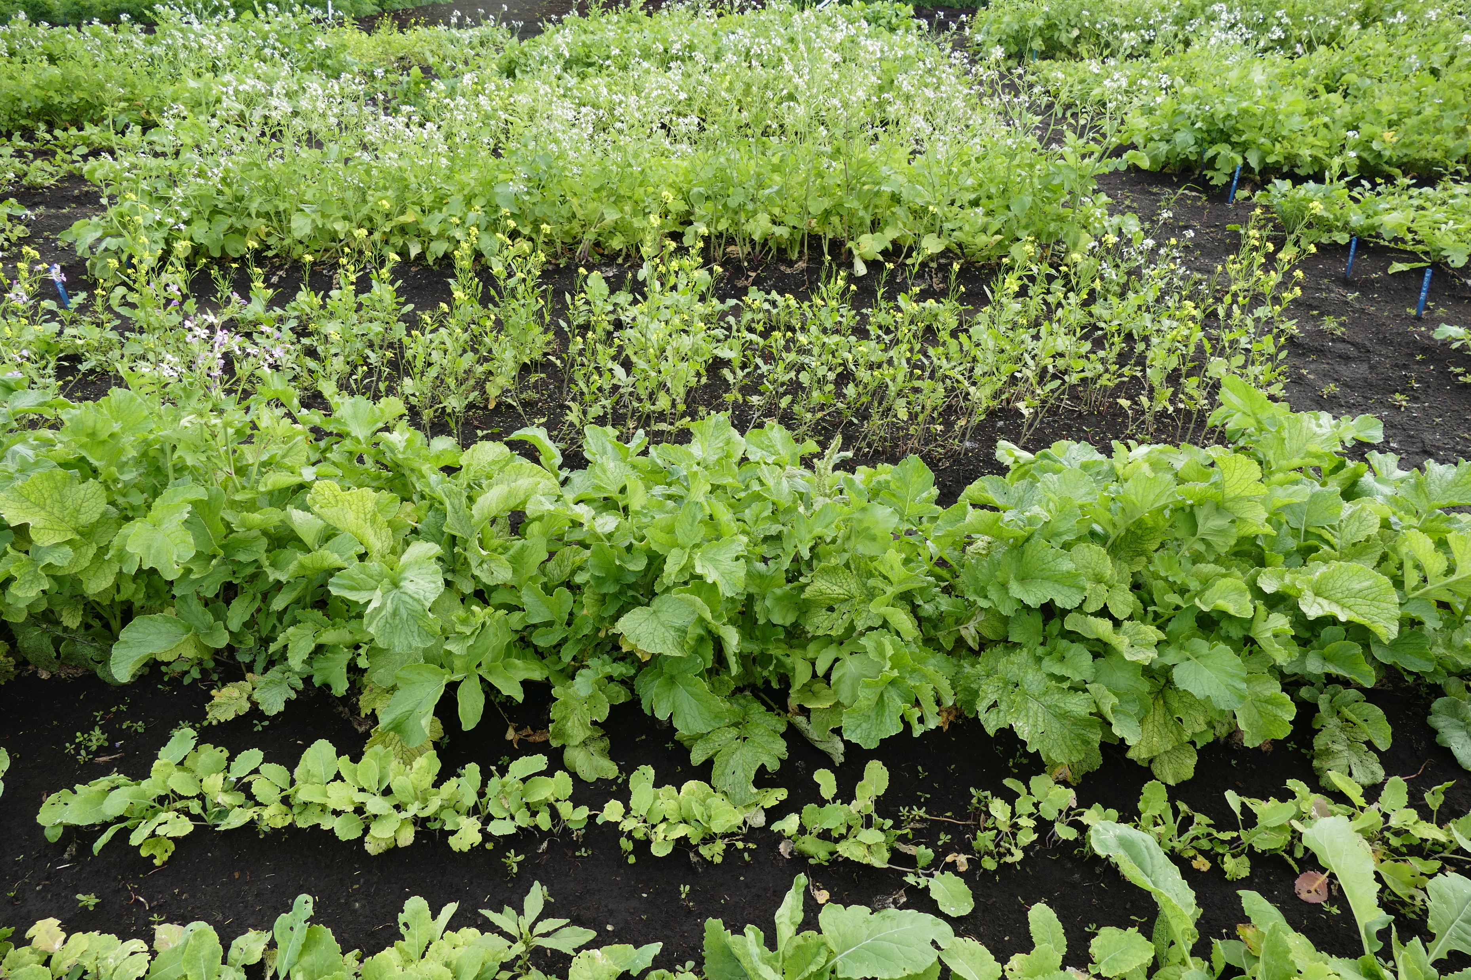
Susceptibility to clubroot in cover crops in the Brassica family

Slide 32
Brassicaceae cover crops vary in susceptibility to clubroot Field trial, pathotype 2
Susceptible (> 40 severity)
Mostly Resistant ( 0- 9 severity)
Dwarf Essex rapeseed
Barscia forage rapeseed
Forage (rapeseed)
Mustard Supreme Blend
Certified Brown mustard
April Cross Radish
Purple Top Turnip
Oilseed radish
White icicle radish
Tillage radish
Groundbreaker radish
Eco-Til Daikon
Barkant turnip
Winifred forage
Highly susceptible Mei Qing Choi (Shanghai pak choi) DSI 50 in this trial

Slide 33
Crop rotation and clubroot
Follow a two year break from canola, or susceptible Brassica crop – but there could still be high numbers of resting spores in the soil
Greatest reduction in resting spores in the first year, some decrease in the second year, then very slow decline
Control volunteer canola, Brassica weeds and avoid most Brassica cover crops
There are many benefits to crop rotation and cover crops beyond clubroot management

Slide 34
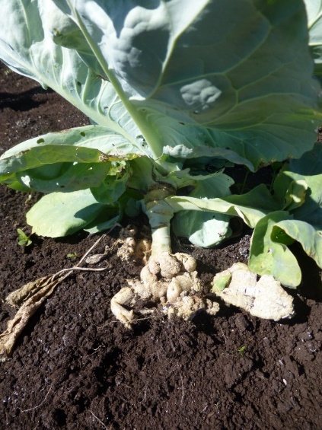
Soil pH
Vegetable growers have known for a long time that raising the pH to 7.2 or above reduces clubroot
Is the effect due to pH or calcium applied as lime?
Treatments:
Gypsum to add calcium without changing pH
Potassium bicarbonate to increase pH with no calcium
Hydrated lime to increase pH and add calcium
Wollastonite to increase pH add calcium and add silicon

Slide 35
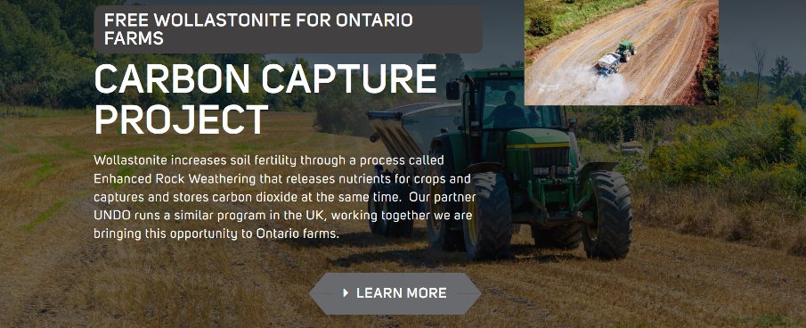
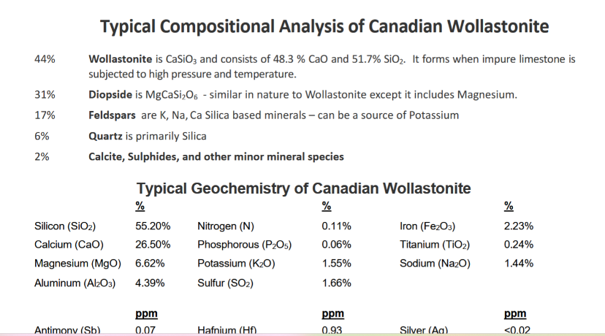

Slide 36
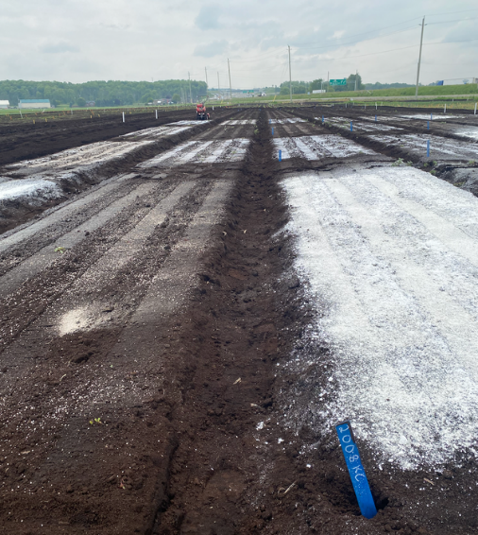
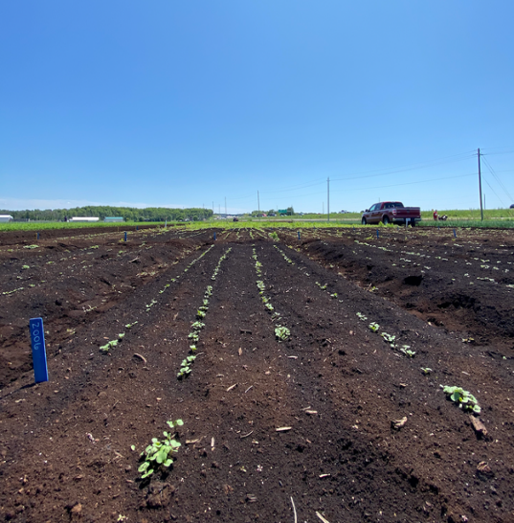
Soil amendments for clubroot
Susceptible pak choy

Slide 37
Effect of pH and calcium on clubroot severity in the field 2024
DSI (0 – 100)
The results indicate that calcium content is not important for suppressing clubroot. PH is the most important

Slide 38
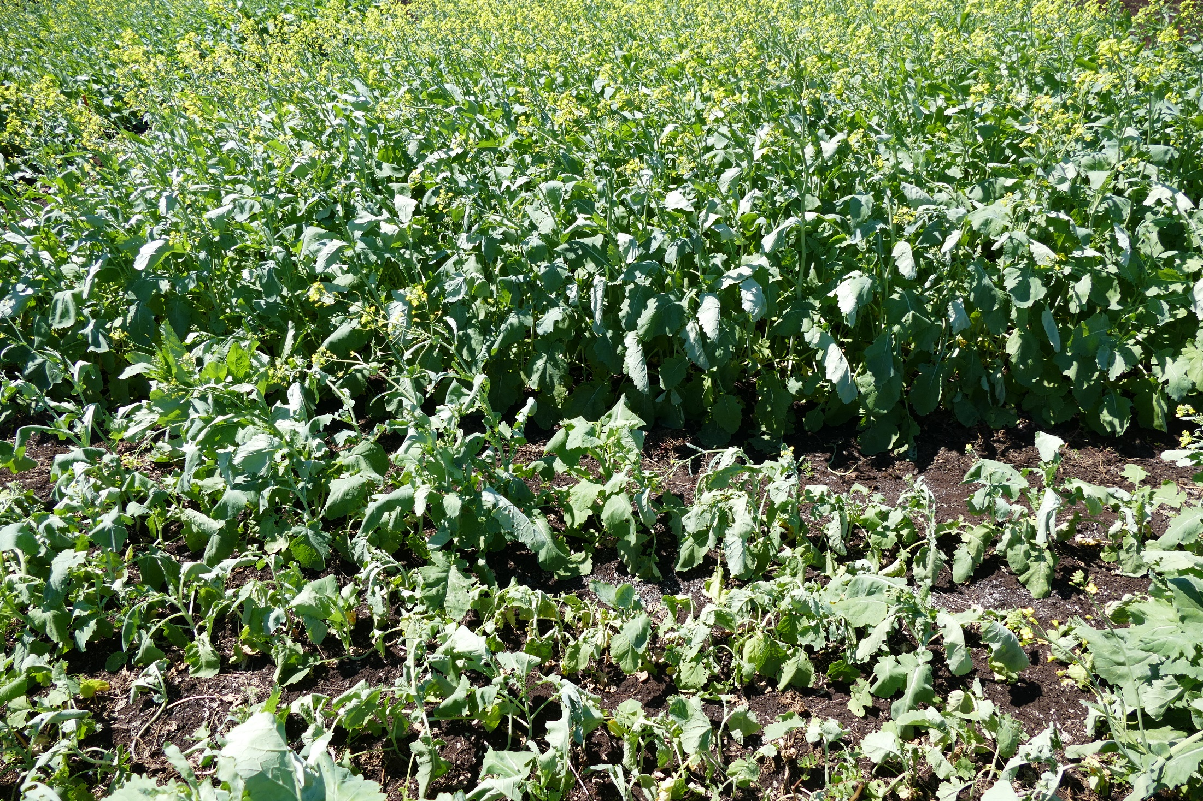
Lime added pH 7.3
Untreated pH 6.3

Slide 39
Effect of pH and temperature on severity of clubroot controlled environment study
Disease severity %
There can still be 40% disease severity at pH 8
When temperature are soil moisture are optimum
Soil pH

Slide 40
What can be done when clubroot is present ?
Crop rotation- keep spore counts low
Grow clubroot resistant cultivars- second generation resistance if clubroot is in your area
Control Brassica weeds in rotation crops
Keep pH high, if possible (Wollastonite?)
Temperature: early crops may have less clubroot
Cover crops to suppress clubroot- possibly

Slide 41
Other clubroot projects: Long term
Molecular methods as a rapid method to determine pathotype - several groups working on this
Biocontrols – none yet
Drone scouting – future research uncertain
Durable resistance to clubroot – many researchers and plant breeders

Slide 42
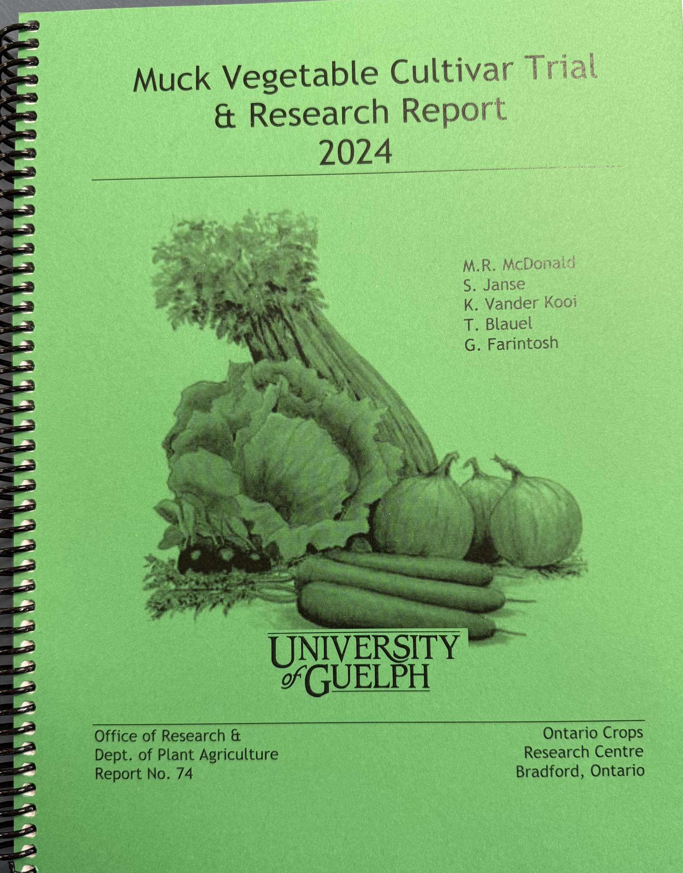
Reports will be available on line at the Ontario Crops Research Center – Bradford web site
We are interested in pathotyping clubs Send clubs to :
Dr. Mary Ruth McDonald
Dept. of Plant Agriculture, Univ. of Guelph.
50 Stone road east, Guelph, ON
N1G2W1
Or contact your crop consultant

Slide 43
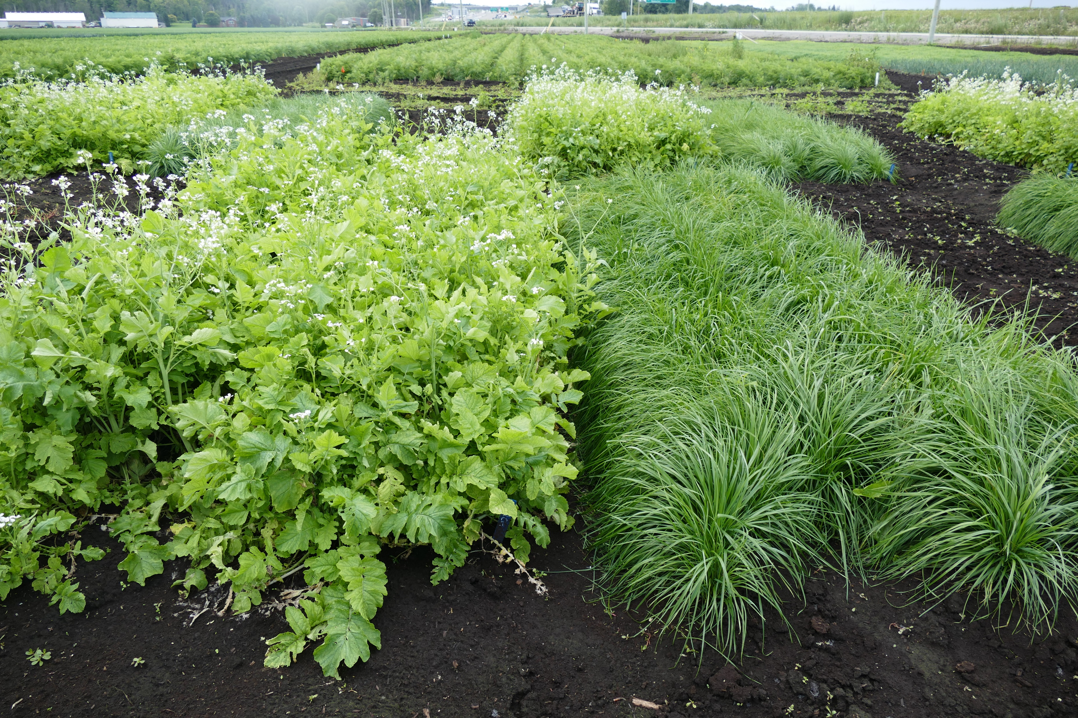
This research was funded by the
  Ontario Canola Growers Association
  Ontario Agri-Food Innovation Alliance,
  National Science, Engineering and Research Council
  Fresh Vegetable Growers of Ontario
  Canola Council of Canada,

Slide 44
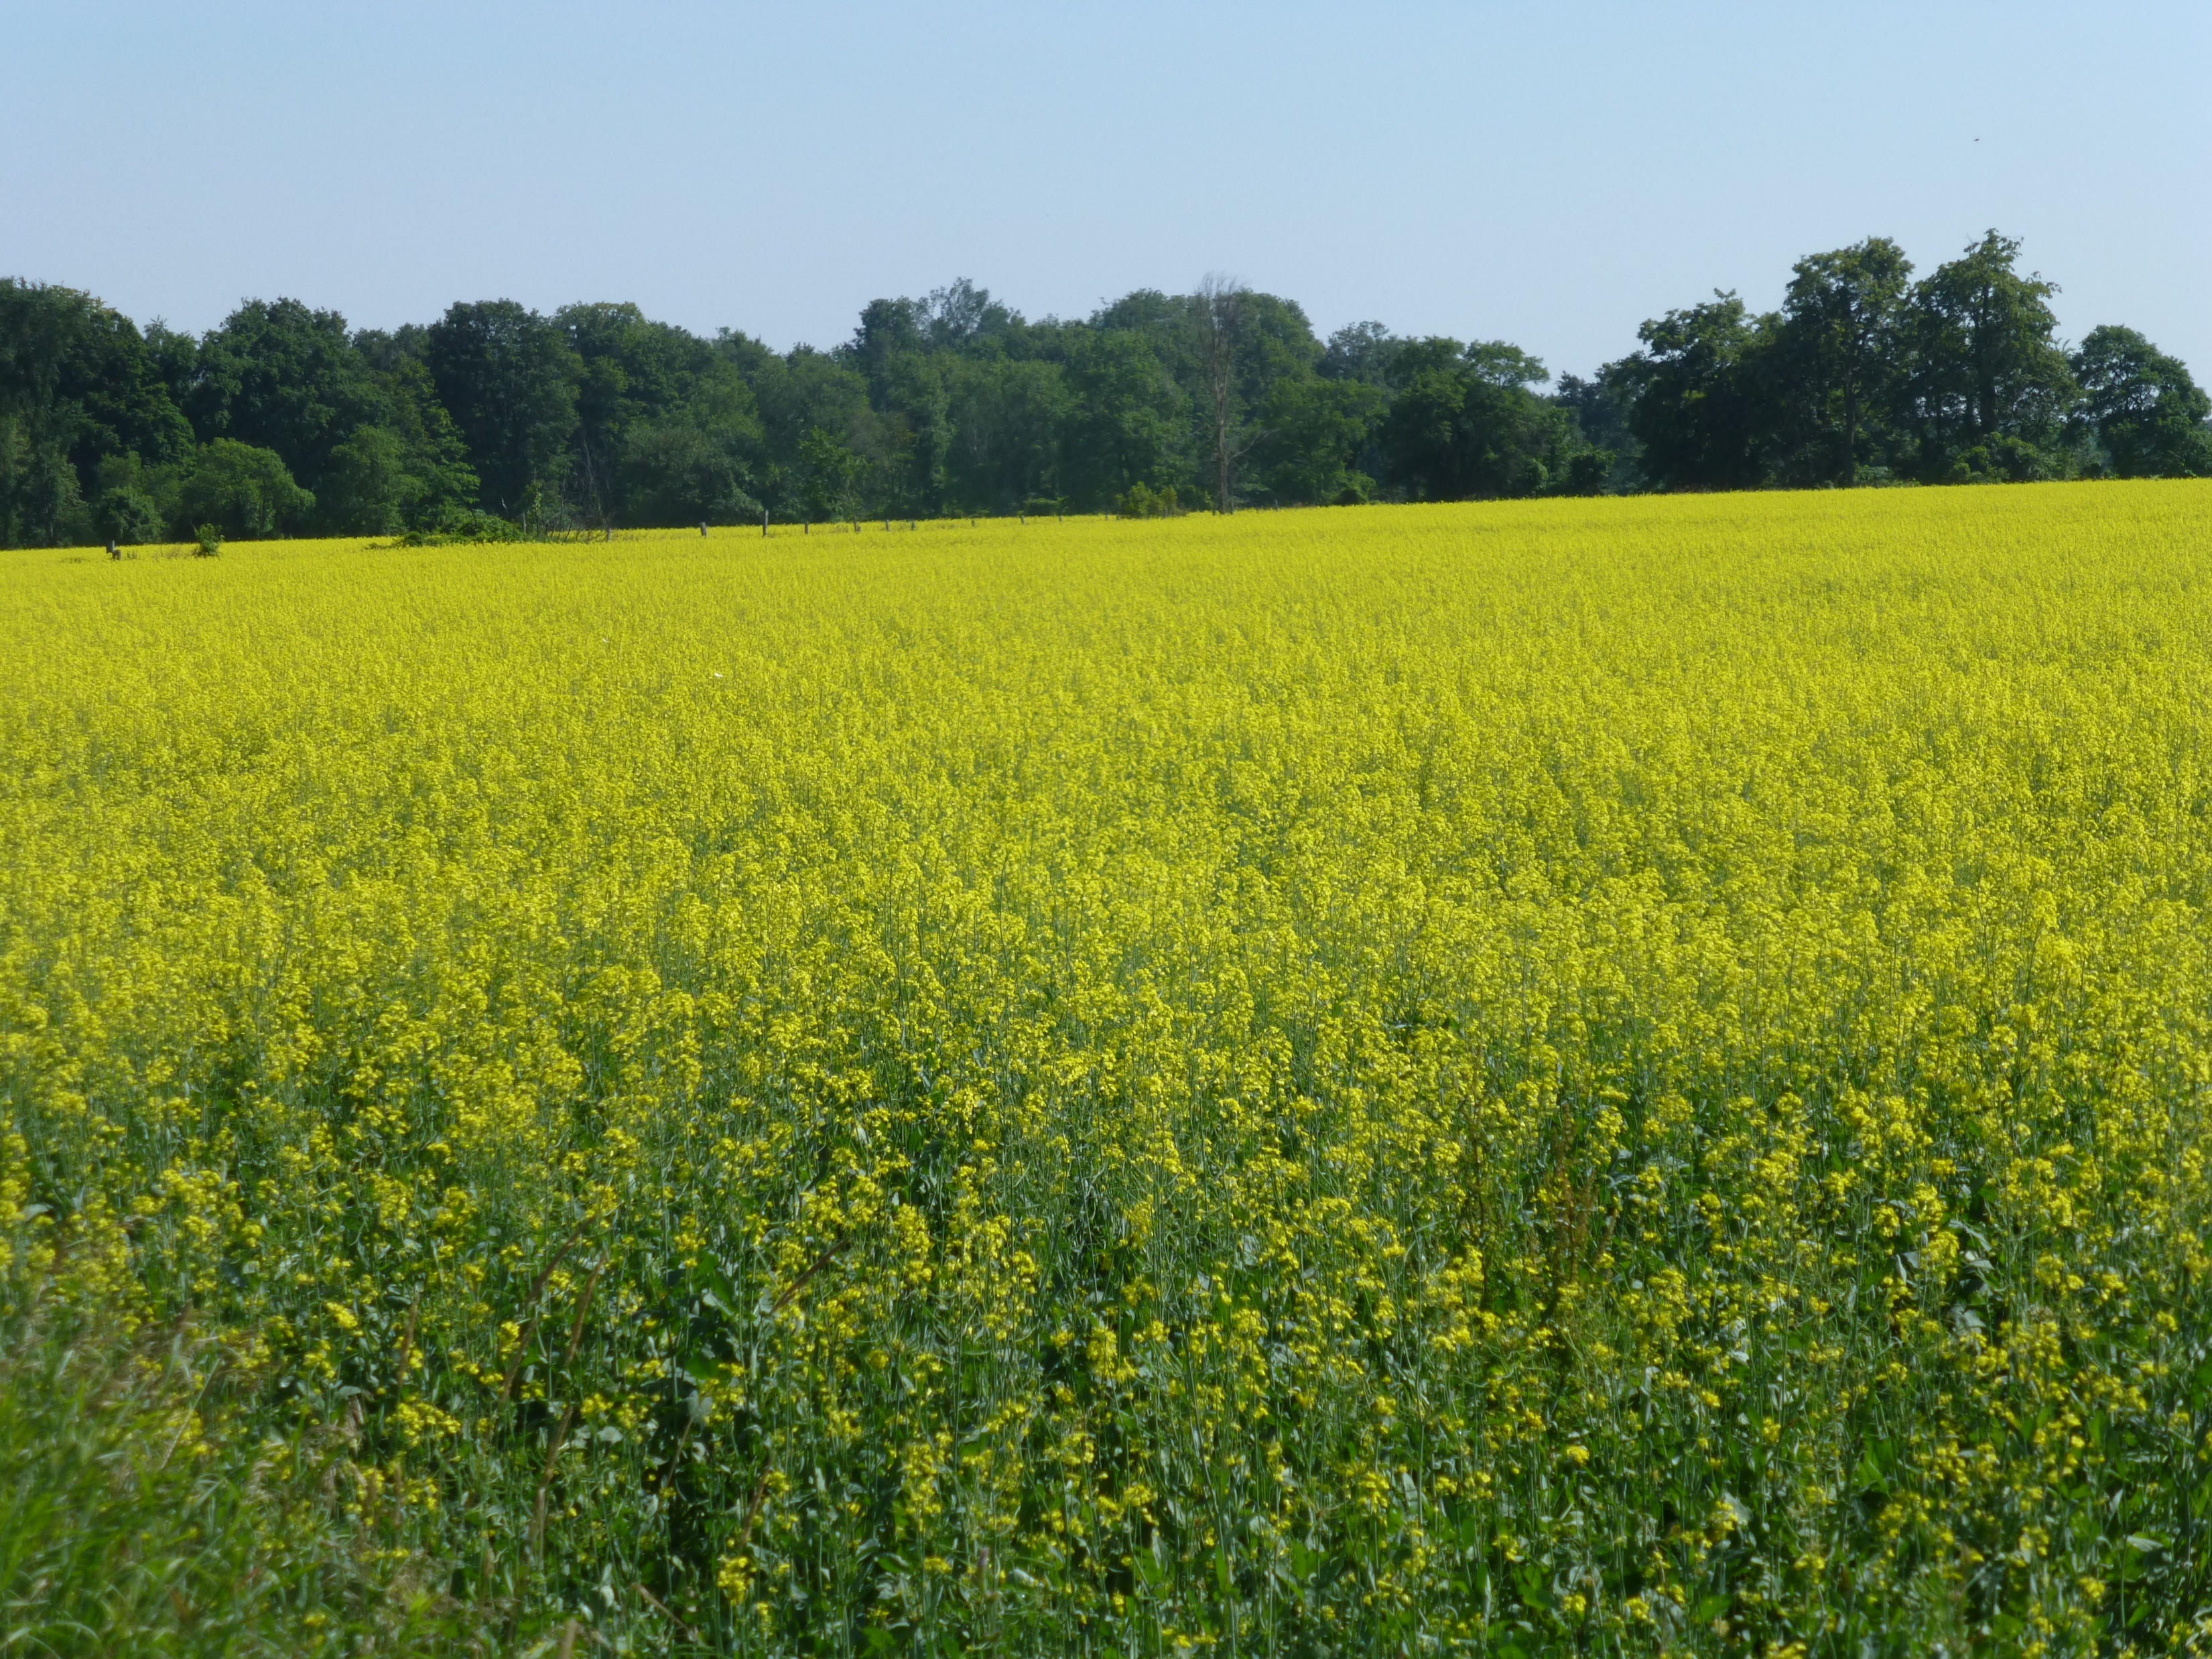
Questions?

Slide 45
Resting spores in soil 2025
Concentration x 1 million

Slide 46
Change in resting spore concentration over time – Saskatchewan
Fallow=
No crop
9 million
One million resting spores per gram can still cause 100% clubroot
3 million
Resting spores decline in the first two years after canola, then very little change

Slide 47
Clubroot: It’s all about resting spore concentration in soil
Conducive conditions:
warm (17- 26 C), wet, compacted, slightly acidic (pH 5.5-6.8) soils.
Still high disease severity under less optimum conditions when spore load is high.
Spore conc. greater than 100,000 g⁻¹ produce consistent infection in susceptible cultivars.
<1,000 1,000 10,000 100,000 1,000,000
Resting spores per gram of soil

Slide 48
Change in resting spore concentration over time – Saskatchewan
Fallow=
No crop
9 million
One million resting spores per gram can still cause 100% clubroot
3 million
Resting spores decline in the first two years after canola, then very little change

Slide 49
Effect of Beauveria on cabbage yield in the field 2024
The Biocontrols increased plant weight compared to the nontreated check
This work will continue in 2025

Slide 50

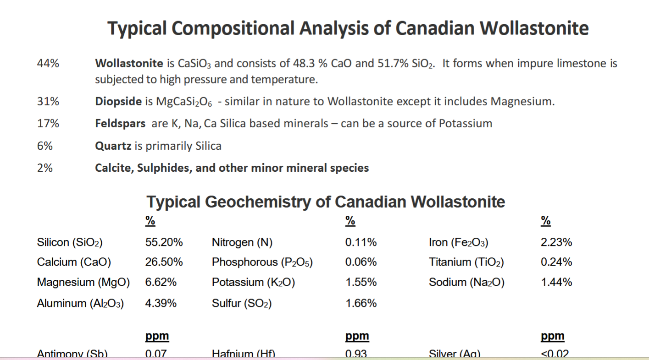

Slide 51
Effect of pH and calcium on clubroot severity in the field 2024
The results indicate that calcium content is not important for suppressing clubroot. pH is the most important. BUT – still some clubroot

Slide 52
Change in resting spore concentration over time – Saskatchewan
Fallow=
No crop
9 million
One million resting spores per gram can still cause 100% clubroot
3 million
Resting spores decline in the first two years after canola, then very little change

Slide 53
Clubroot resistance is related to pathotypes of P. brassicae
A pathotype (strain) can cause disease on one crop or cultivar, but not another
  Pathotype 6 causes clubroot on vegetables but little clubroot on canola
  The pathotypes are changing with new genes for cubroot resistance in canola.
  The most important change is the ability to overcome ‘first generation’ resistance in canola.
  We sometimes call this an ‘x’ pathotype
  Pathotypes in Ontario: 2, 3, 5 and 8

Slide 54
Summary - clubroot
Liming to increase the pH definitely reduces clubroot.
The pH is important, not calcium
Freezing and thawing of clubs reduces resting spores a bit (~ 20- 30%)

Slide 55
Resting spores in soil 2025
Concentration x 1 million

Slide 56
Why did the new pathotypes develop so quickly and what can be done to stop this rapid change?
There can be a billion resting spores in one club = lots more in a field.
There are different pathotypes in a club, certainly in a field
Growing a resistant variety is the best way to manage clubroot BUT this also selects for rare pathoptypes that can overcome resistance
Essential to keep resting spore numbers low:
More spores = more chance of resistance breaking down

Slide 57
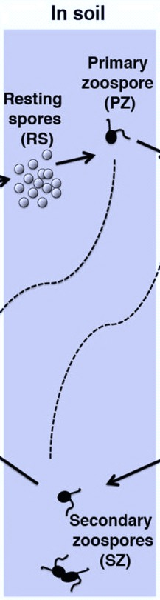
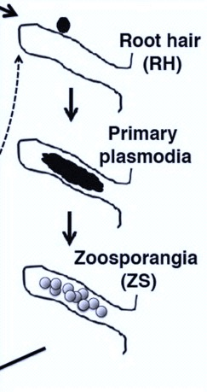
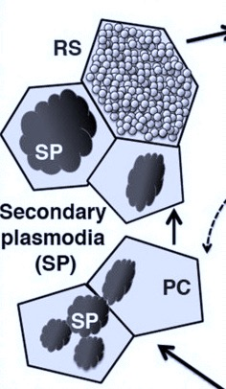
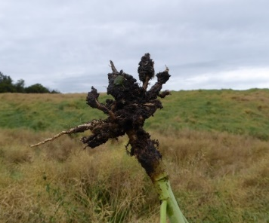
Life cycle of P. brassicae
Plant root
Plant root
P. brassicae is an obligate parasite:
it only reproduces in living plant material
Arne Schwelm et al., 2015
Notes:
A biflagellate primary zoospore (PZ) is released from each resting spore (RS). When the PZ reaches the surface of a root hair (RH) (a), it penetrates the cell wall and forms primary plasmodia in the root hairs. After a number of nuclear divisions the plasmodia cleaves into zoosporangia (ZS), developing and releasing secondary zoospores (SZ) (b). Occasional fusion of SZ has been suggested. PZ or SZ can penetrate root cortex cells, in which the pathogen develops into secondary plasmodia (SP) (c–f). Proliferation of SP is associated with cellular hypertrophy, causing a swollen root or club phenotype (Supplementary Fig. S1). After a number of nuclear divisions, the secondary plasmodia develop into multinuclear plasmodia and finally into resting spores (f–i), which are released into the surrounding soil when plants decay. RS = Resting spore, PZ = Primary zoospore, RH = root hair, ZS = Zoosporangia, SZ = Secondary zoospore, SP = Secondary plasmodia. PC = Plant cell, PCW = Plant cell wall
It starts its life cycle by resting spores. The resting spores are really small but they can persist in the soil for several years.

Slide 58
Vegetable growers have known for a long time that raising the pH to 7.2 or above reduces clubroot
Is the effect due to pH or calcium?
Treatments:
Gypsum to add calcium without changing pH
Potassium bicarbonate to increase pH with no calcium
Lime to increase pH and add calcium
Wollanstonite to increase pH add calcium and add silicon

Slide 59
Clubroot severity on cabbage treated with B. bassiana before transplanting
Controlled environment trial

Slide 60
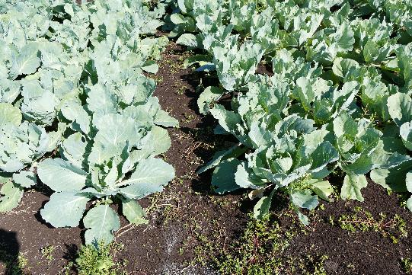
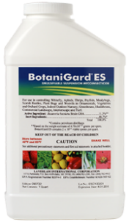
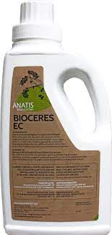
Beauveria as Bioceres and Botanigard applied as a drench to transplants in the greenhouse
2021- Bioceres reduced insect damage but no effect on clubroot ( 32% vs 45%)
2022- Reduced clubroot but not insect damage (9 vs 53%)
No effect in the field in 2023

Slide 61
Clubroot on canola usually shows up as small patches, often near the field entrance (where it came in on soil on equipment)

Slide 62
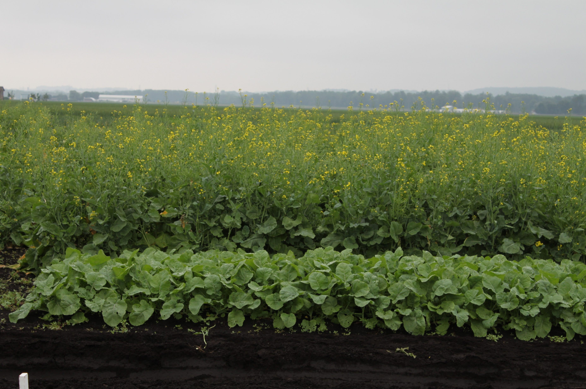
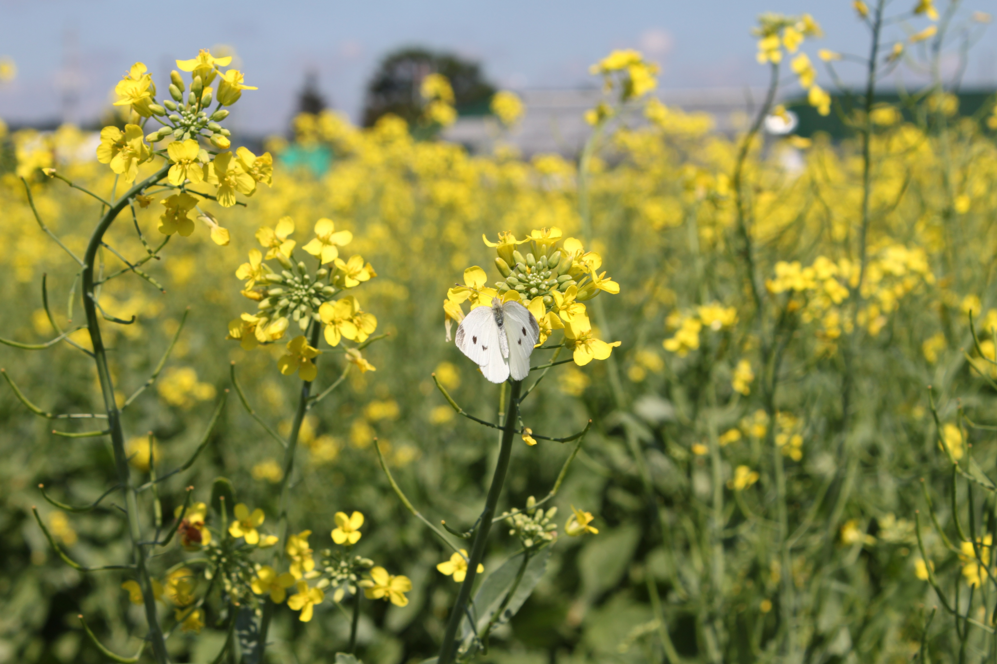

Slide 63
qPCR for 2024

Slide 64
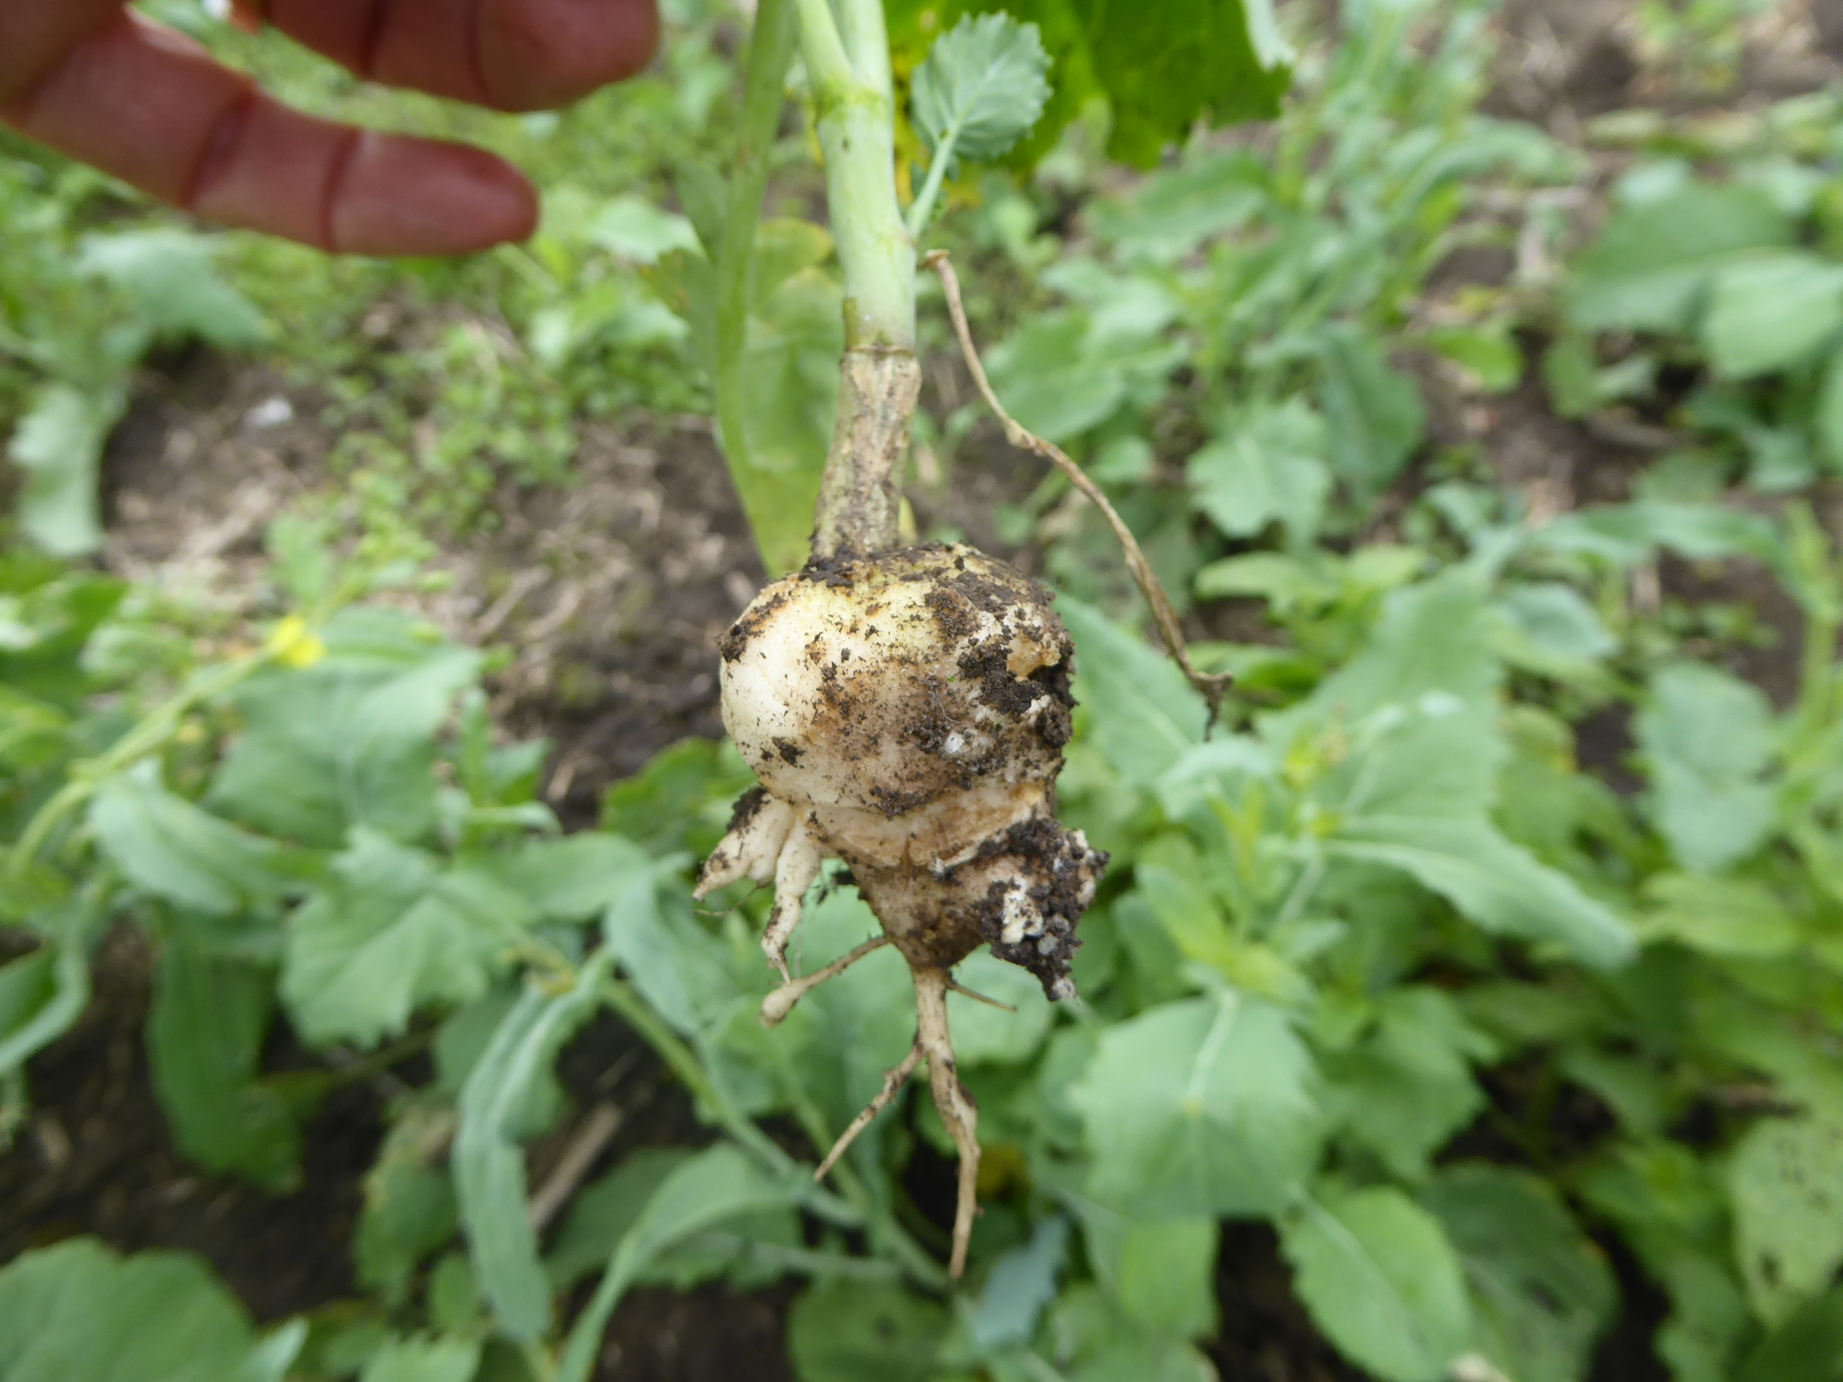
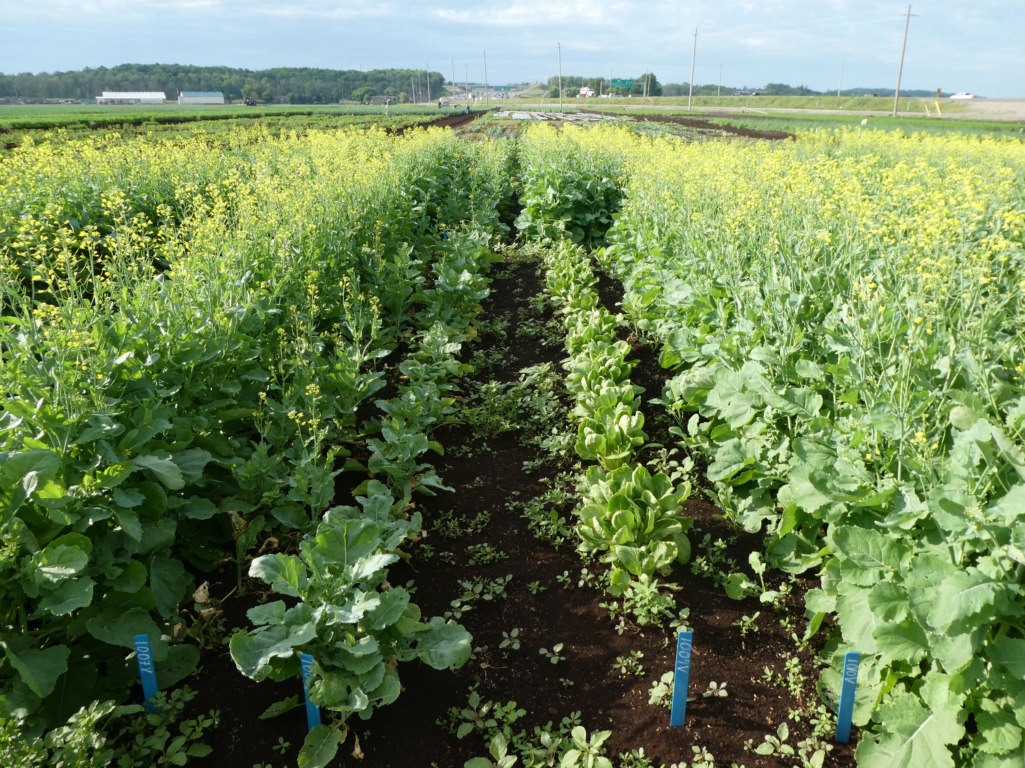


Slide 65
Recommendations and approaches for clubroot management
Prevent introduction
Avoid infested fields
Crop rotation – 5 to 7 years (old recommendation)
Currently: 2 year break from a susceptible crop
Lime to pH 7.2 or above
Resistance, if available in a suitable cultivar
Biocontrols?
Fungicides at transplanting?
Fumigation?

Slide 66
Reduction in resting spores over time
10^^{x} resting spores per gram
High numbers of resting spores (100 million) at the start can mean a 90% (100 million to 10 million) reduction, or a 99% reduction (100 to 1million ) in spore concentration =
100% disease severity in a bioassay, or in the field
100 million
10 million
1 million
Year from last susceptible crop

Slide 67
Monitoring and Management of Clubroot on Brassica vegetables
Effect of pH and/or calcium
Cover crops
Endophyte Beauveria bassiana
(Bioceres and Botanigard)
Freezing and thawing
Pathotypes
We are still interested in testing clubs for pathotype
Also looking for a mineral soil site with clubroot for a field trial

Slide 68
Effect of cyazofamid and seeding date on clubroot severity Field trial - 2009
Ranman (cyazofamid) suppressed clubroot on 3 of the seeding dates

Slide 69
Resting spores in soil 2024
Concentration x 1 million

Slide 71
Fungicide Efficacy, 2024

